Slide 1
By Jasper Bradley

Slide 2
About NSV
Norfolk Scrubs Volunteers was created by my mum and four others in March, just after lock down!
They realised that Norfolk front line care workers and NHS staff needed more scrubs than they had already. So they formed Norfolk Scrubs Volunteers.

Slide 3
What are scrubs?
Scrubs are clothing worn by Nurses, Doctors and Carers who look after patients. The reason they wear scrubs is because scrubs are designed to be simple (not many places for nasty bugs to hide), easy to clean and cheap to replace if they get stained.

Slide 4
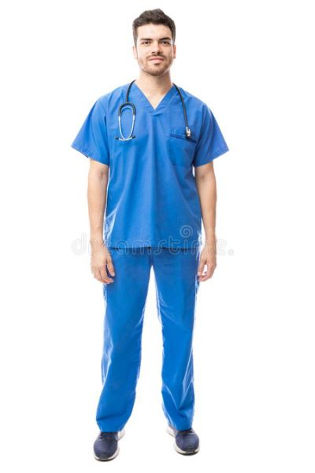
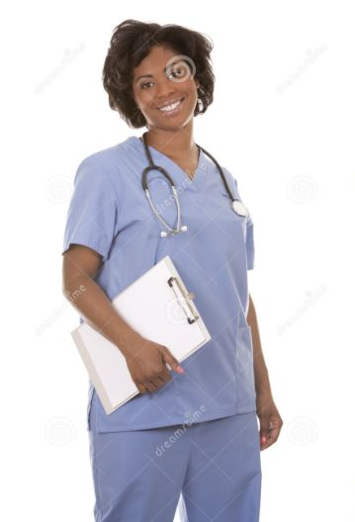
These are Scrubs

Slide 5
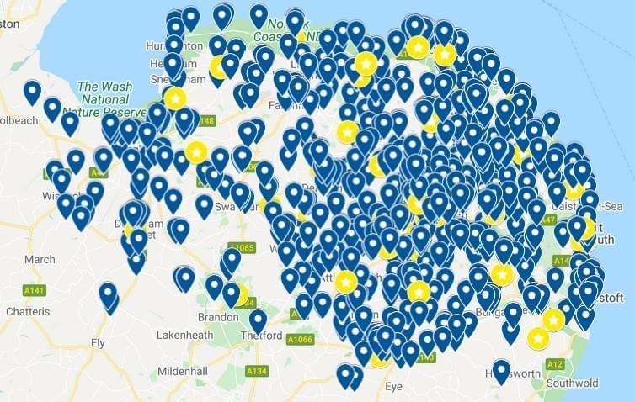
The Stats
Norfolk Scrubs Volunteers was set up and got hundreds wanting to help make scrubs to protect front line care workers.
So far, they have over 1,200 people registered to sew and make scrubs and have raised over £40,000 to buy supplies and used over 20,000 metres of fabric.
Each marker on the map is a sewer!

Slide 6
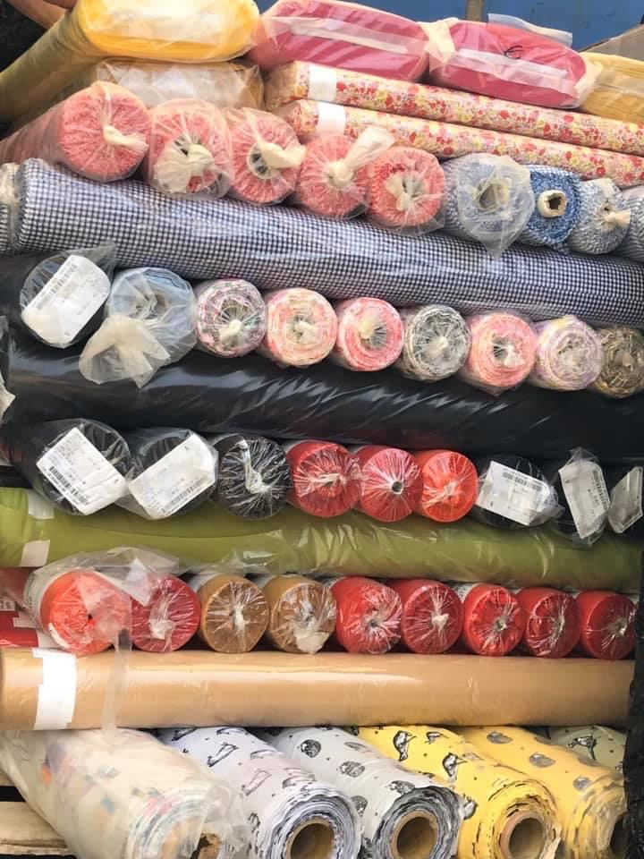
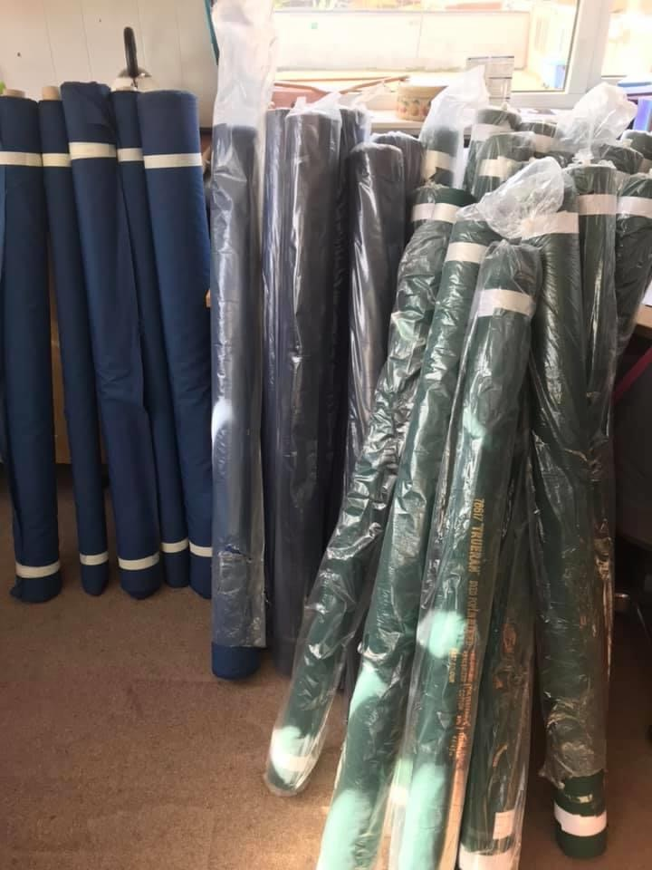
Some of the fabric that was used

Slide 7
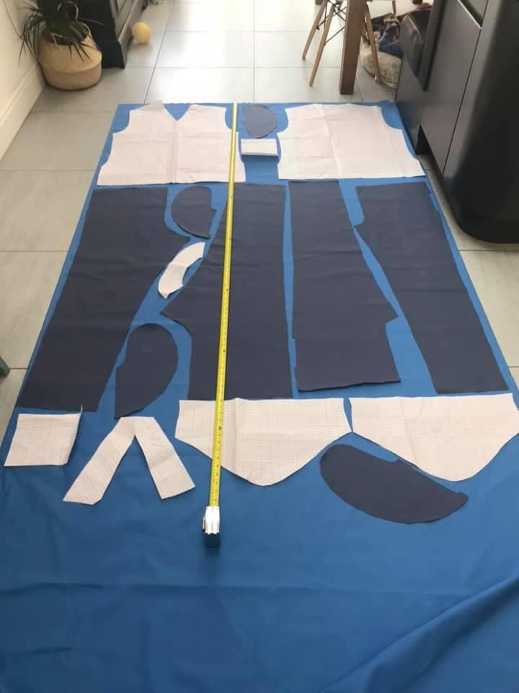
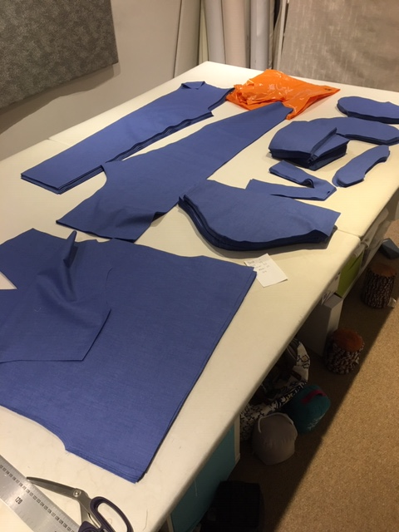
This is fabric being cut out before it is sewn together to make scrubs

Slide 8
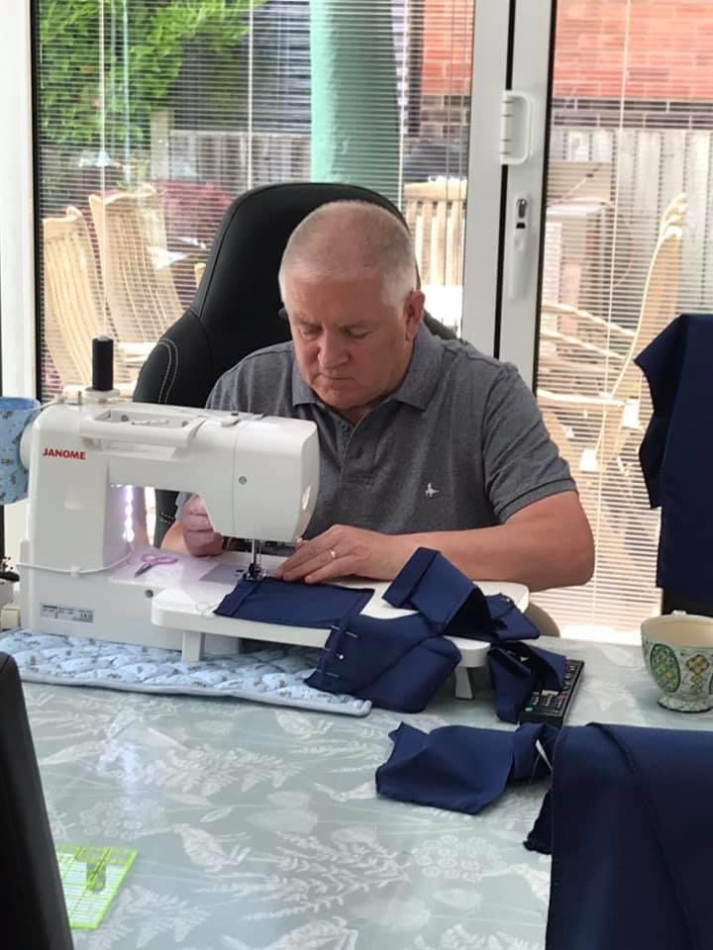
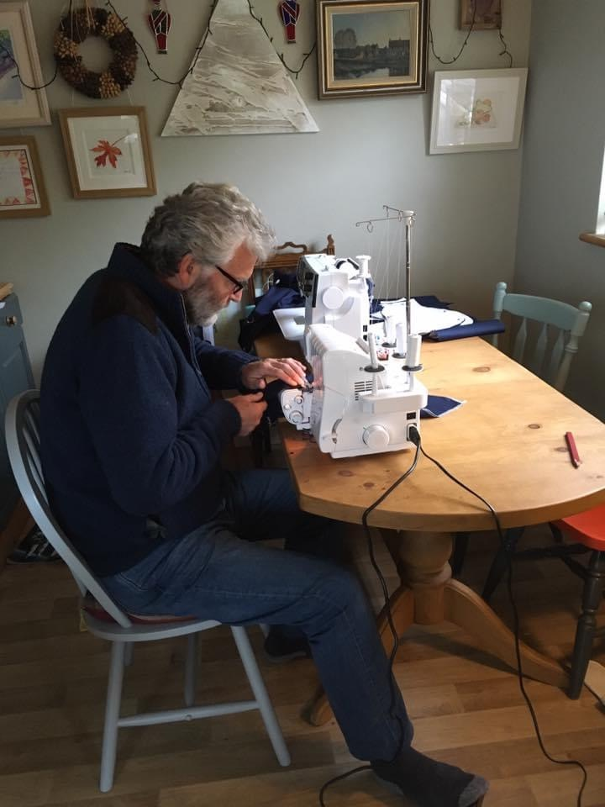
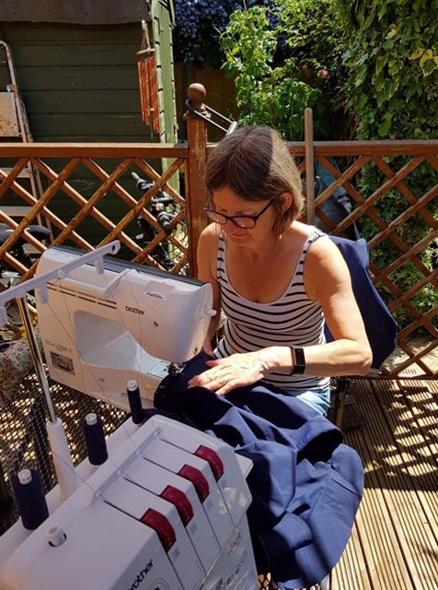
Some of the sewers hard at work

Slide 9
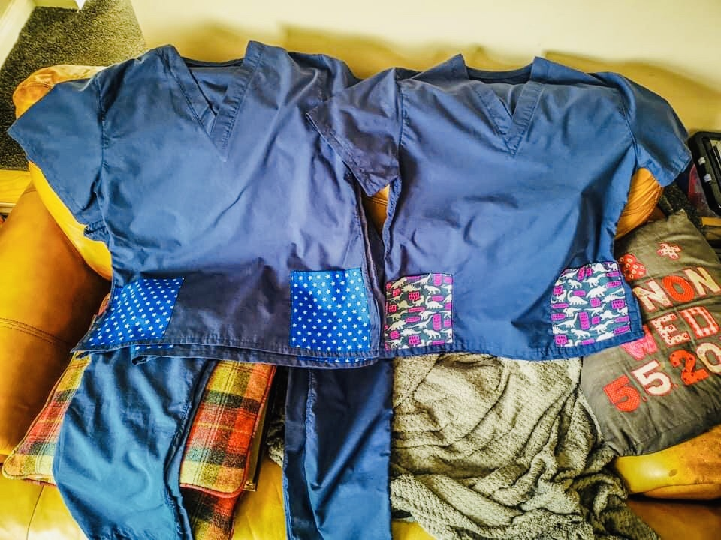
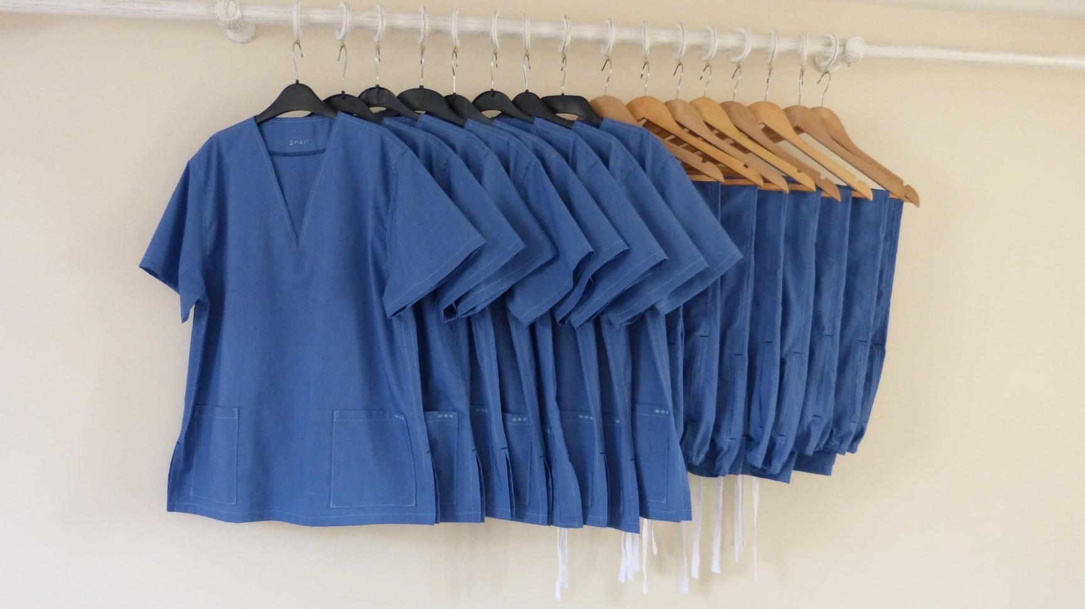
Some scrubs made by the volunteers

Slide 10
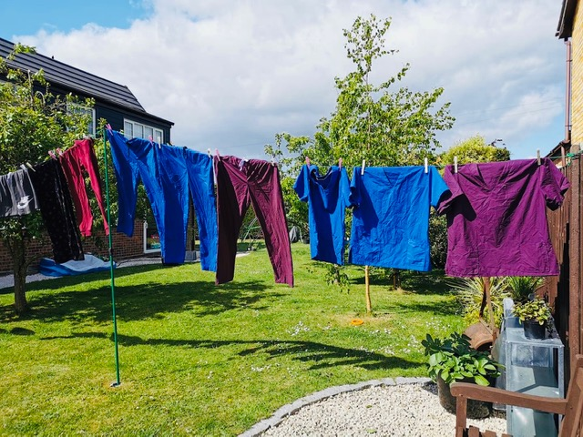
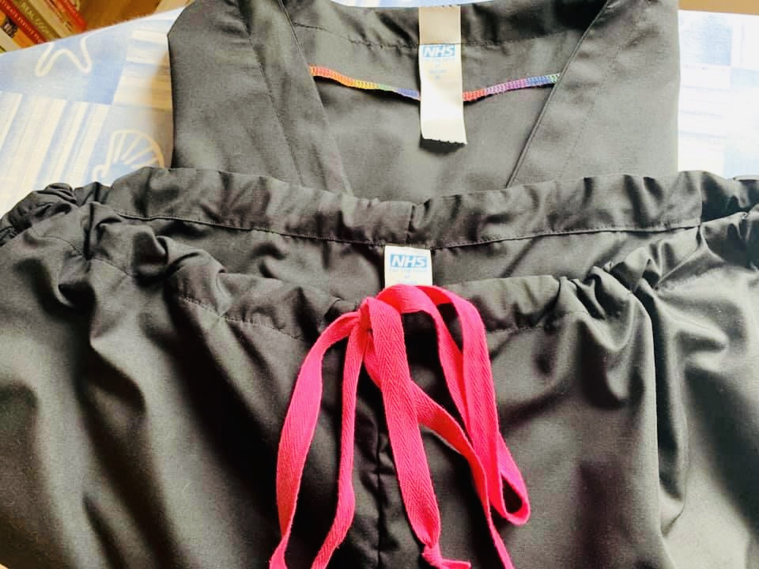
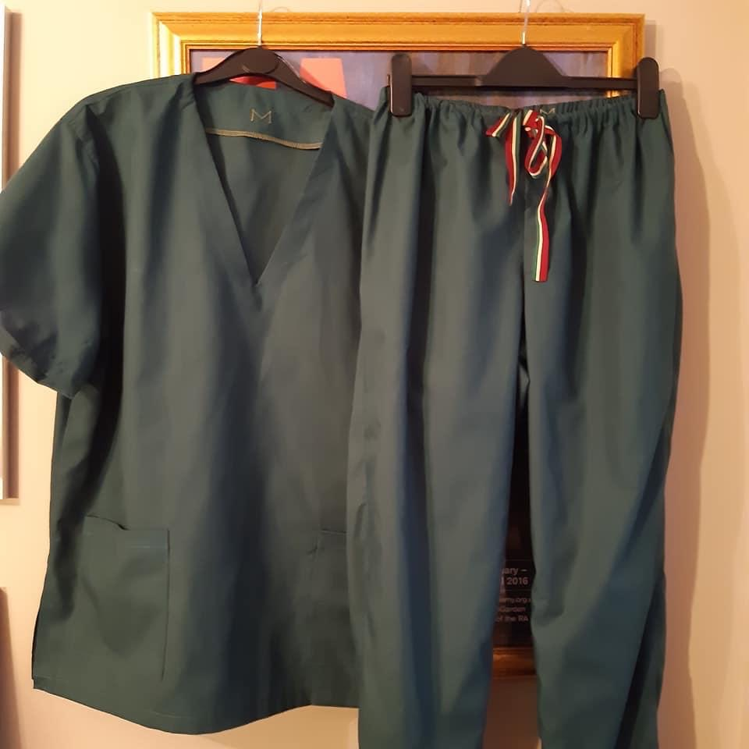
Some more scrubs made by the volunteers

Slide 11
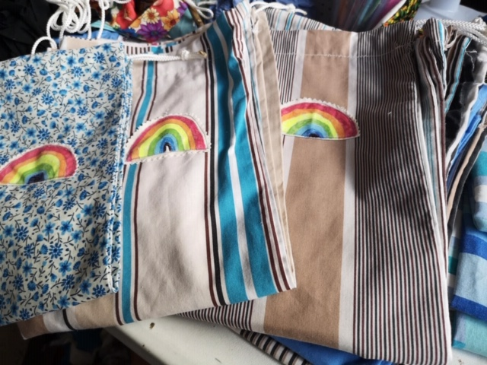
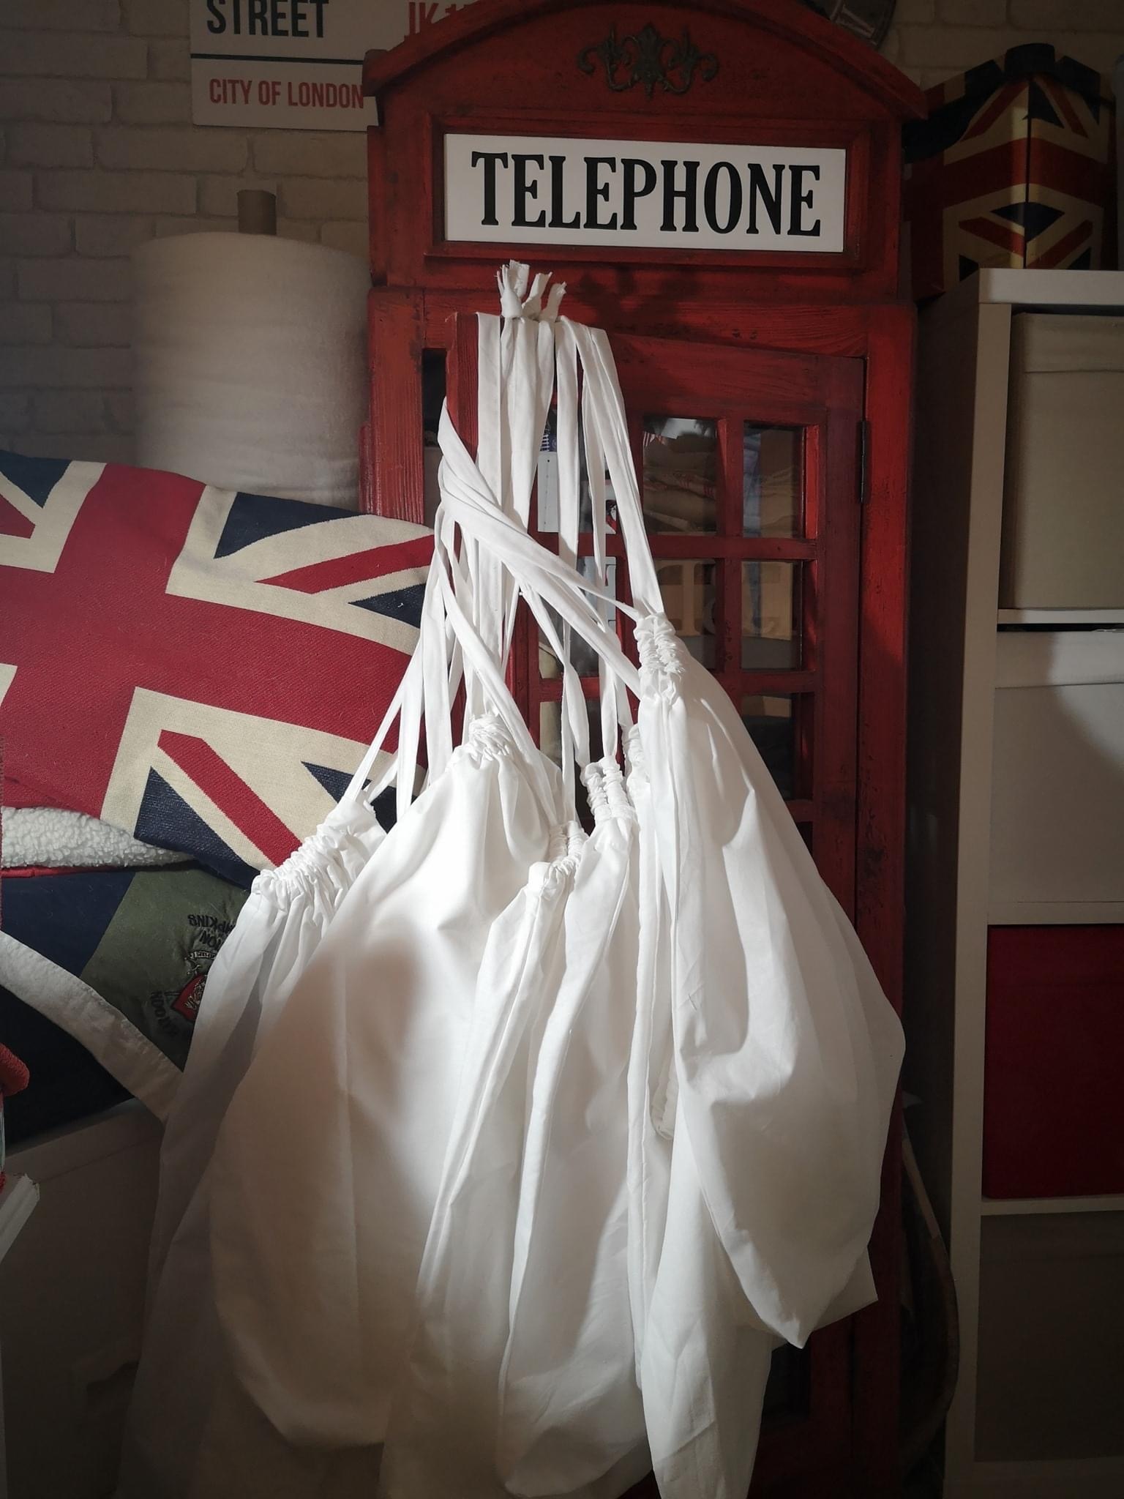
They also make laundry bags to keep the scrubs in after they are worn

Slide 12
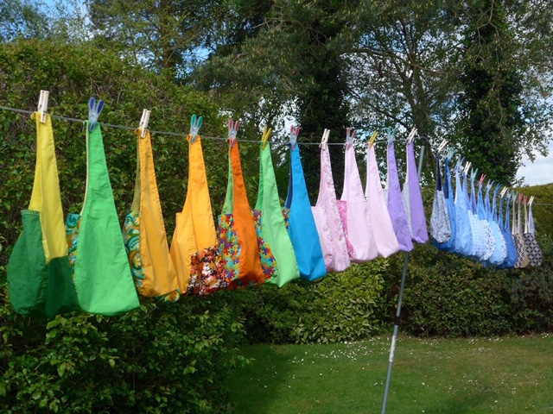
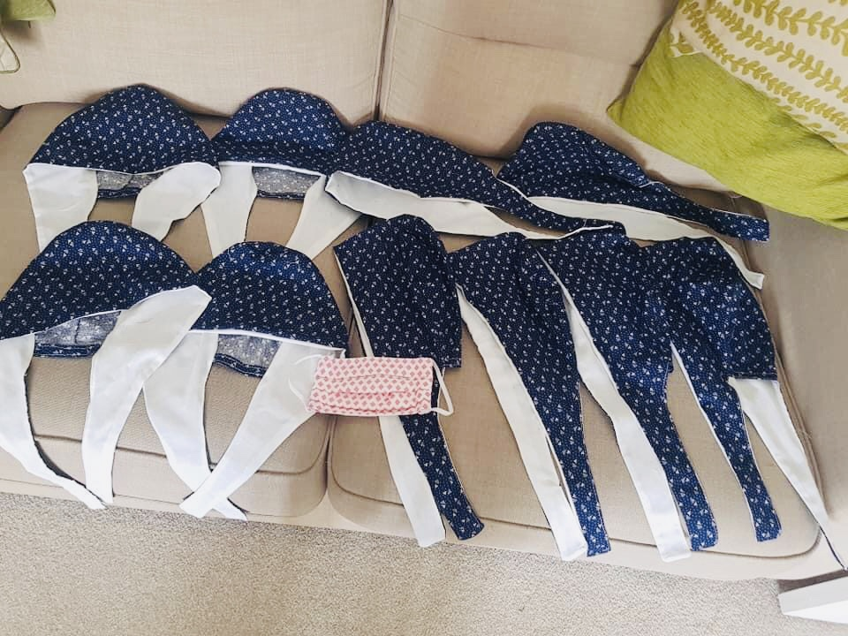
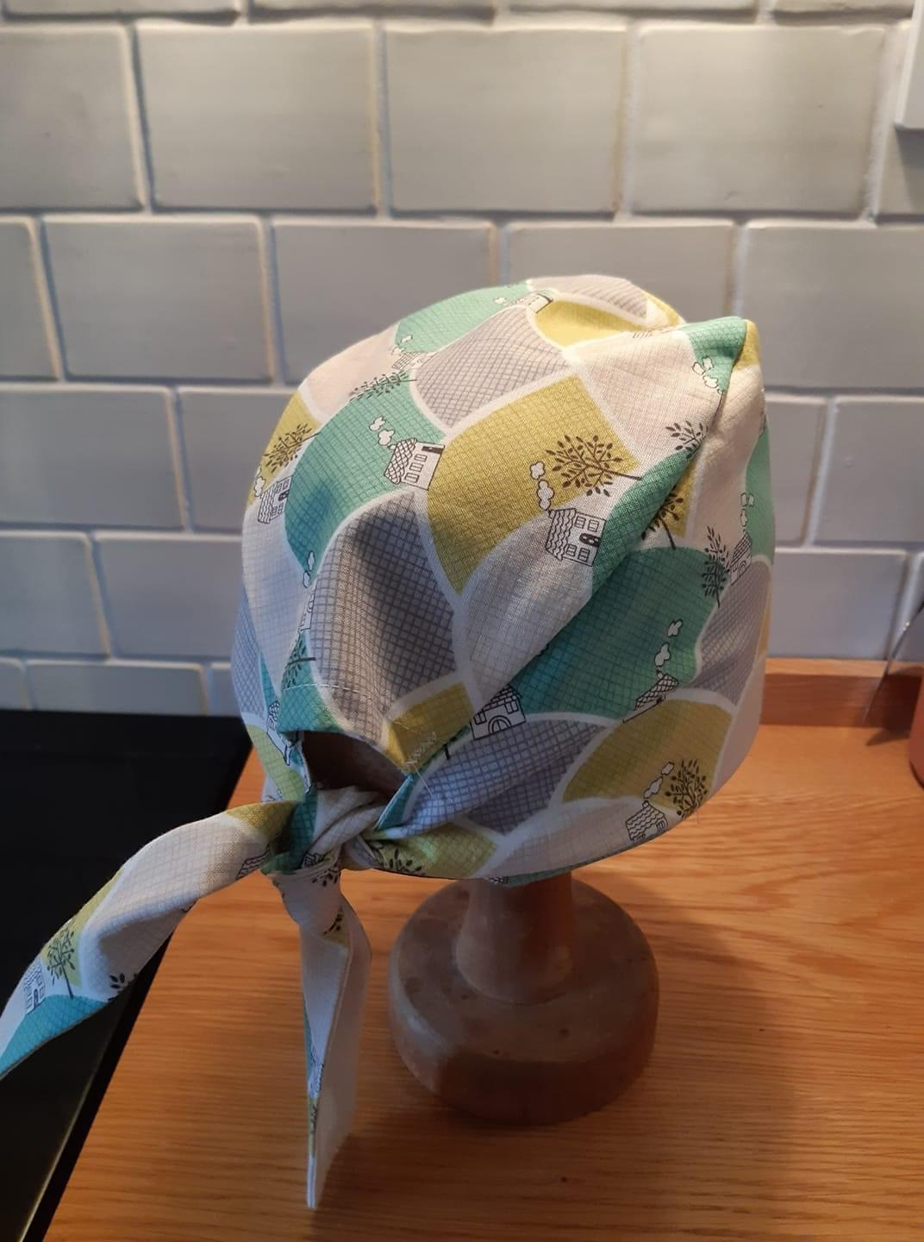
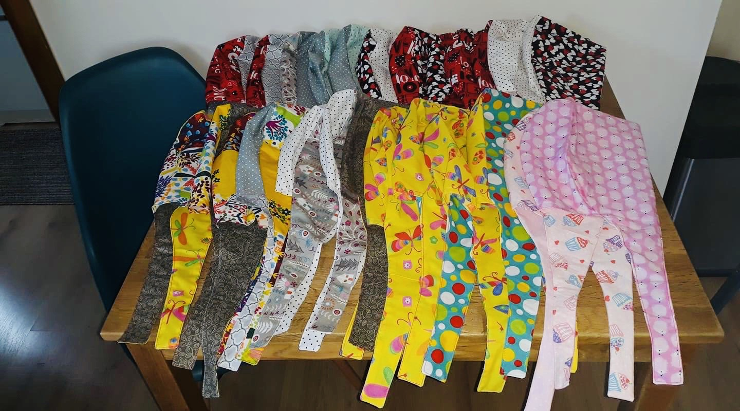
And scrub hats

Slide 13
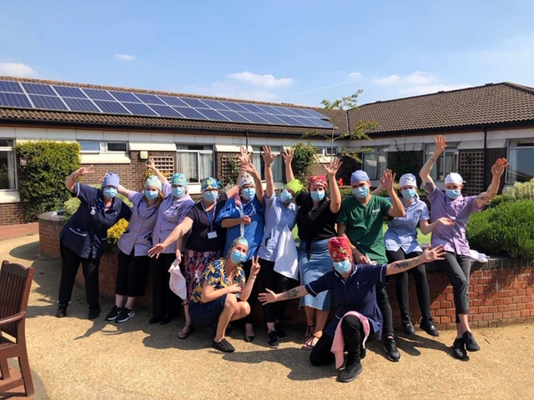
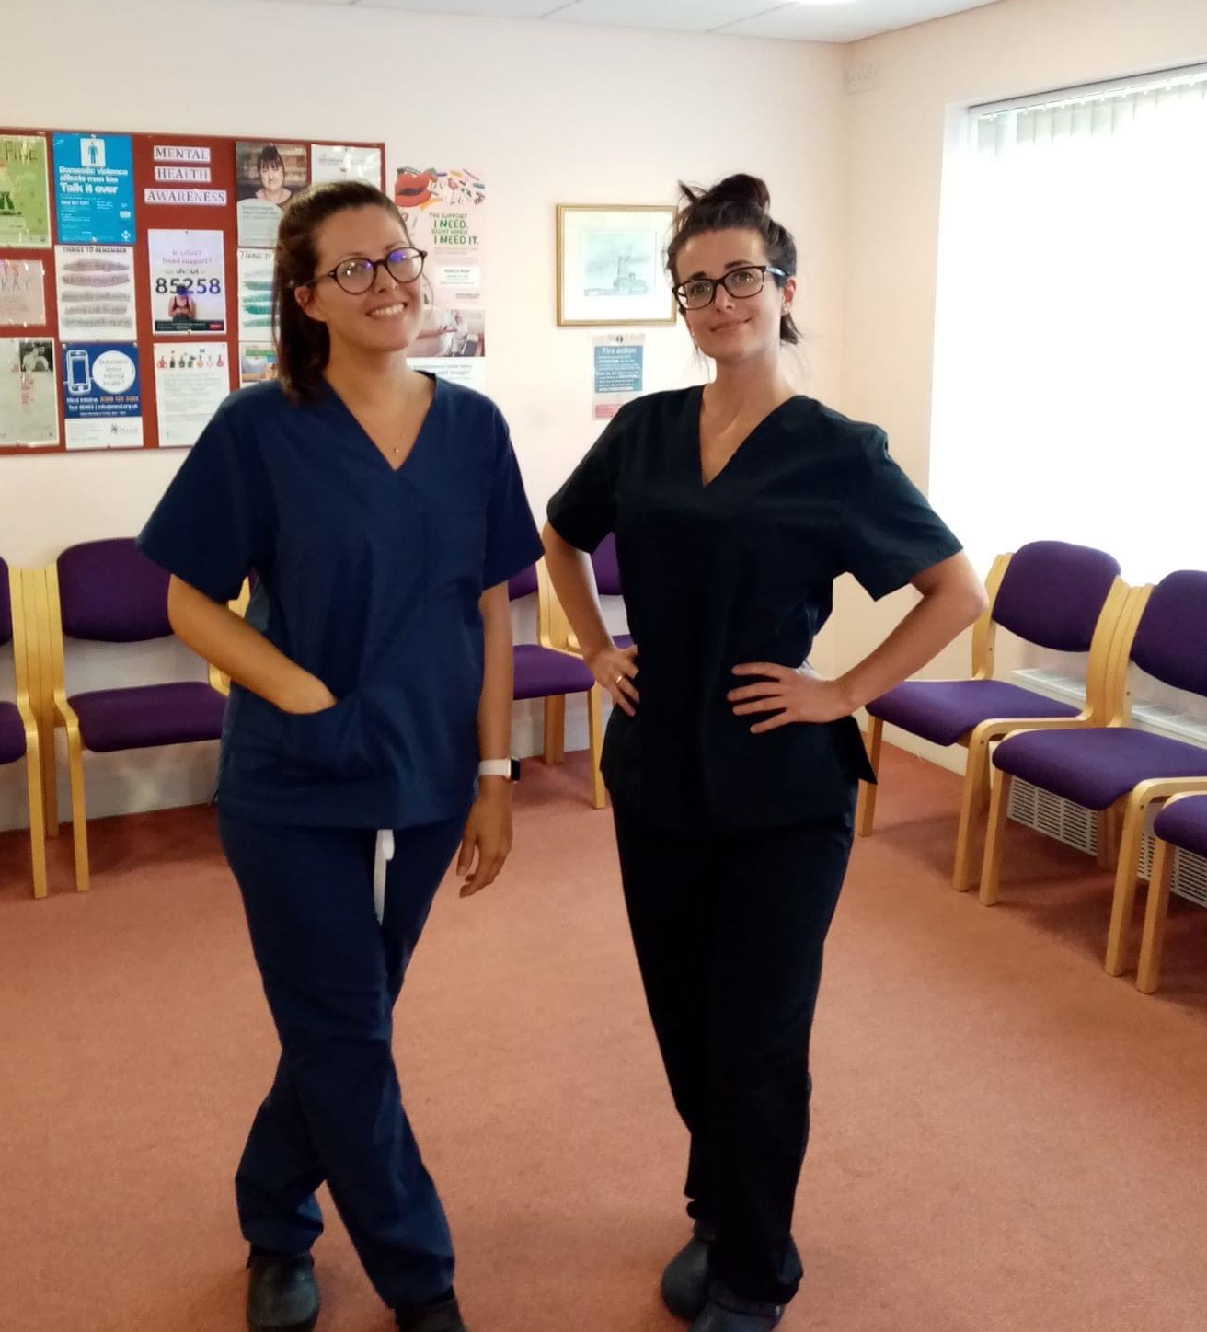
Where are they going?
So far, they have delivered over 2,600 sets of scrubs, over 3,700 laundry bags and over 750 scrub hats to front line care workers in doctors surgeries, hospitals and care homes all over Norfolk

Slide 14
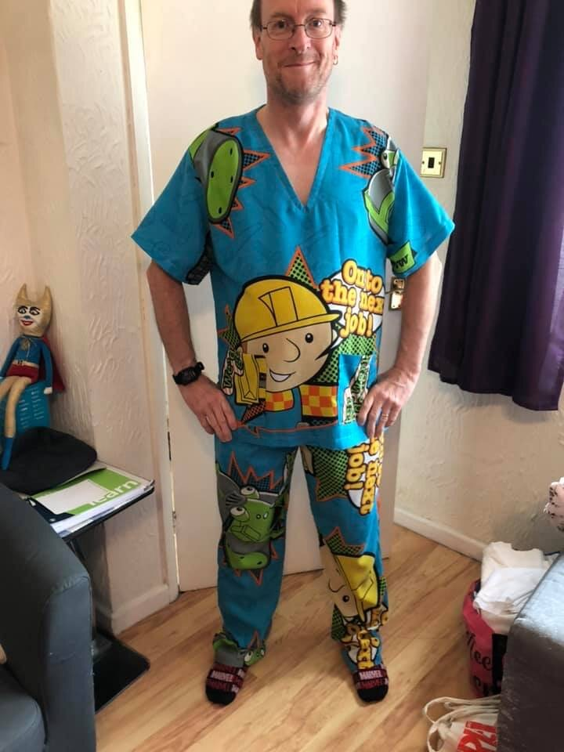
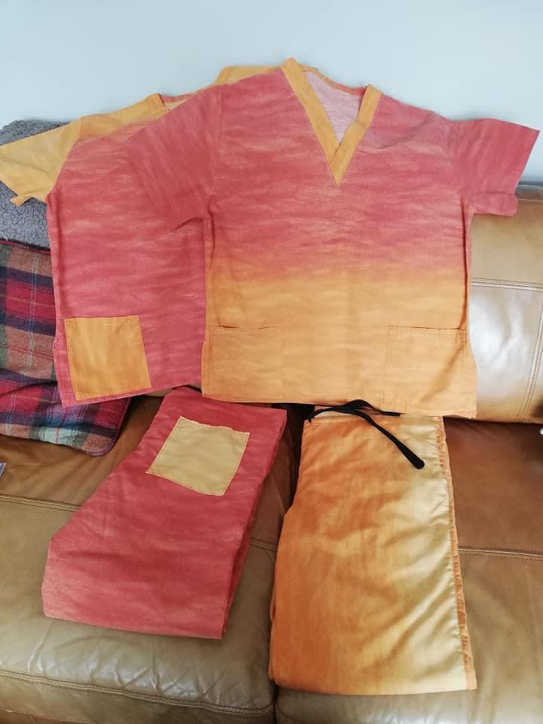
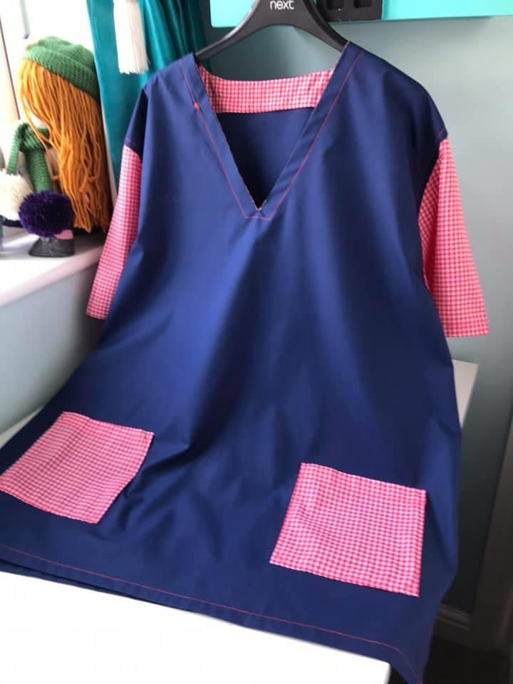
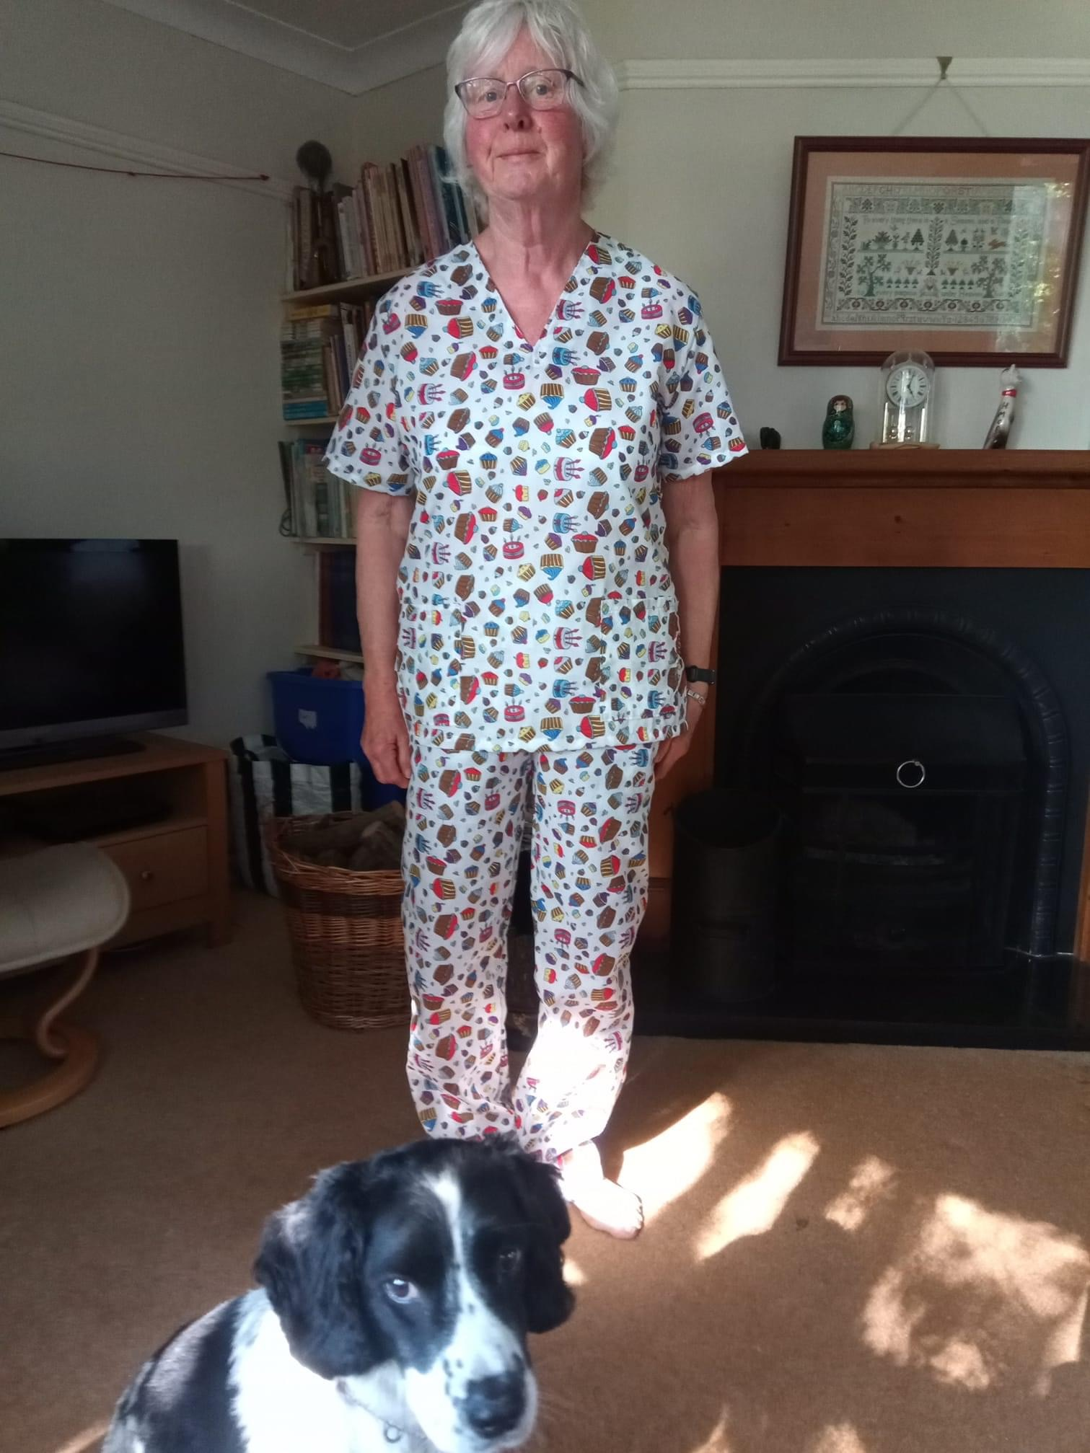
And finally, most scrubs were made with blue fabric but these people were more creative

Slide 15
