Slide 1

Online Meeting 30th April
  Animal Anagrams
shif
Notes:
OK, so we’re going to play a cartoon character quiz, in a moment we’ll reveal a simplified image of some famous cartoon characters and we’d like you to put the answer into the chat. Are you ready> her goes…

Slide 2

Online Meeting 30th April
  Animal Anagrams
fish
Notes:
OK, so we’re going to play a cartoon character quiz, in a moment we’ll reveal a simplified image of some famous cartoon characters and we’d like you to put the answer into the chat. Are you ready> her goes…

Slide 3
Online Meeting 30th April
  Animal Anagrams
acrb
Notes:
OK, so we’re going to play a cartoon character quiz, in a moment we’ll reveal a simplified image of some famous cartoon characters and we’d like you to put the answer into the chat. Are you ready> her goes…

Slide 4
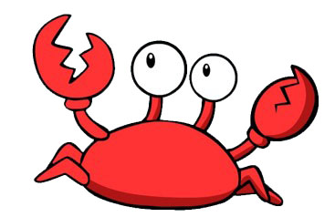
Online Meeting 30th April
  Animal Anagrams
crab
Notes:
OK, so we’re going to play a cartoon character quiz, in a moment we’ll reveal a simplified image of some famous cartoon characters and we’d like you to put the answer into the chat. Are you ready> her goes…

Slide 5
Online Meeting 30th April
  Animal Anagrams
toga
Notes:
OK, so we’re going to play a cartoon character quiz, in a moment we’ll reveal a simplified image of some famous cartoon characters and we’d like you to put the answer into the chat. Are you ready> her goes…

Slide 6
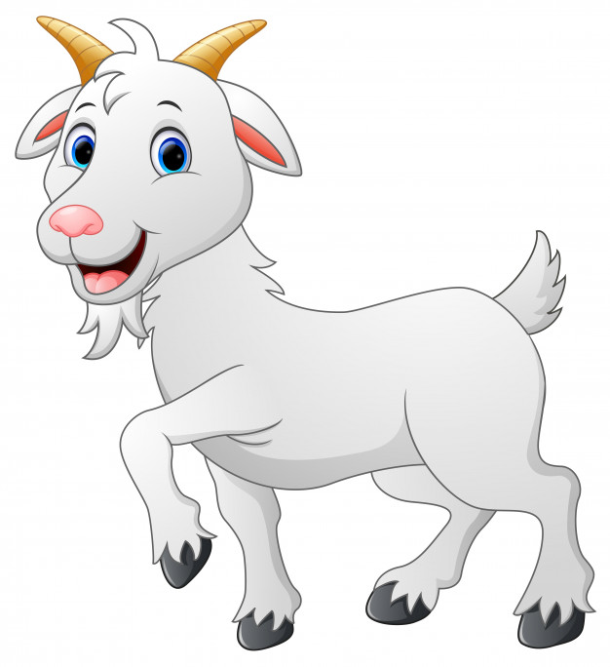
Online Meeting 30th April
  Animal Anagrams
goat
Notes:
OK, so we’re going to play a cartoon character quiz, in a moment we’ll reveal a simplified image of some famous cartoon characters and we’d like you to put the answer into the chat. Are you ready> her goes…

Slide 7
Online Meeting 30th April
  Animal Anagrams
emuos
Notes:
OK, so we’re going to play a cartoon character quiz, in a moment we’ll reveal a simplified image of some famous cartoon characters and we’d like you to put the answer into the chat. Are you ready> her goes…

Slide 8
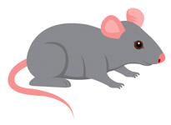
Online Meeting 30th April
  Animal Anagrams
mouse
Notes:
OK, so we’re going to play a cartoon character quiz, in a moment we’ll reveal a simplified image of some famous cartoon characters and we’d like you to put the answer into the chat. Are you ready> her goes…

Slide 9
Online Meeting 30th April
  Animal Anagrams
rabez
Notes:
OK, so we’re going to play a cartoon character quiz, in a moment we’ll reveal a simplified image of some famous cartoon characters and we’d like you to put the answer into the chat. Are you ready> her goes…

Slide 10
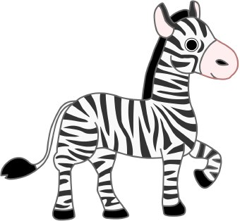
Online Meeting 30th April
  Animal Anagrams
zebra
Notes:
OK, so we’re going to play a cartoon character quiz, in a moment we’ll reveal a simplified image of some famous cartoon characters and we’d like you to put the answer into the chat. Are you ready> her goes…

Slide 11
Online Meeting 30th April
  Animal Anagrams
mecla
Notes:
OK, so we’re going to play a cartoon character quiz, in a moment we’ll reveal a simplified image of some famous cartoon characters and we’d like you to put the answer into the chat. Are you ready> her goes…

Slide 12
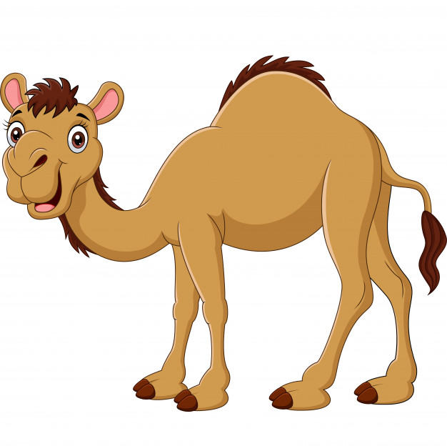
Online Meeting 30th April
  Animal Anagrams
camel
Notes:
OK, so we’re going to play a cartoon character quiz, in a moment we’ll reveal a simplified image of some famous cartoon characters and we’d like you to put the answer into the chat. Are you ready> her goes…

Slide 13
Online Meeting 30th April
  Animal Anagrams
redsip
Notes:
OK, so we’re going to play a cartoon character quiz, in a moment we’ll reveal a simplified image of some famous cartoon characters and we’d like you to put the answer into the chat. Are you ready> her goes…

Slide 14
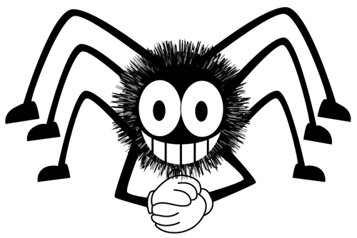
Online Meeting 30th April
  Animal Anagrams
spider
Notes:
OK, so we’re going to play a cartoon character quiz, in a moment we’ll reveal a simplified image of some famous cartoon characters and we’d like you to put the answer into the chat. Are you ready> her goes…

Slide 15
Online Meeting 30th April
  Animal Anagrams
hatheec
Notes:
OK, so we’re going to play a cartoon character quiz, in a moment we’ll reveal a simplified image of some famous cartoon characters and we’d like you to put the answer into the chat. Are you ready> her goes…

Slide 16
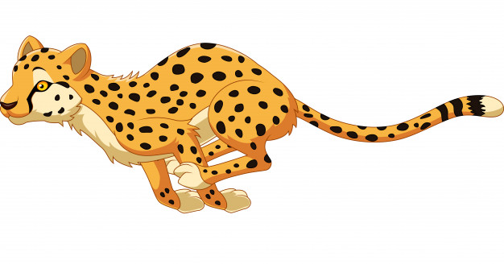
Online Meeting 30th April
  Animal Anagrams
cheetah
Notes:
OK, so we’re going to play a cartoon character quiz, in a moment we’ll reveal a simplified image of some famous cartoon characters and we’d like you to put the answer into the chat. Are you ready> her goes…

Slide 17
Online Meeting 30th April
  Animal Anagrams
koymen
Notes:
OK, so we’re going to play a cartoon character quiz, in a moment we’ll reveal a simplified image of some famous cartoon characters and we’d like you to put the answer into the chat. Are you ready> her goes…

Slide 18
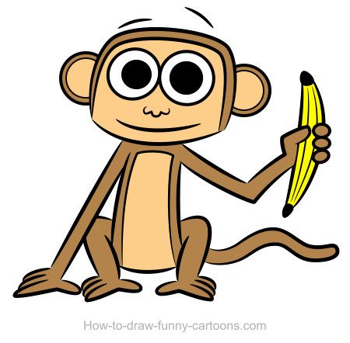
Online Meeting 30th April
  Animal Anagrams
monkey
Notes:
OK, so we’re going to play a cartoon character quiz, in a moment we’ll reveal a simplified image of some famous cartoon characters and we’d like you to put the answer into the chat. Are you ready> her goes…

Slide 19
Online Meeting 30th April
  Animal Anagrams
uspopophimat
Notes:
OK, so we’re going to play a cartoon character quiz, in a moment we’ll reveal a simplified image of some famous cartoon characters and we’d like you to put the answer into the chat. Are you ready> her goes…

Slide 20
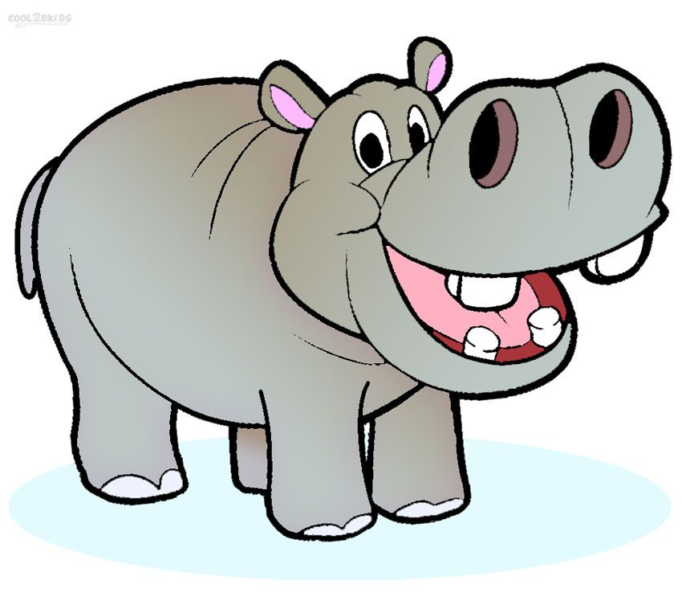
Online Meeting 30th April
  Animal Anagrams
hippopotamus
Notes:
OK, so we’re going to play a cartoon character quiz, in a moment we’ll reveal a simplified image of some famous cartoon characters and we’d like you to put the answer into the chat. Are you ready> her goes…

