Slide 1

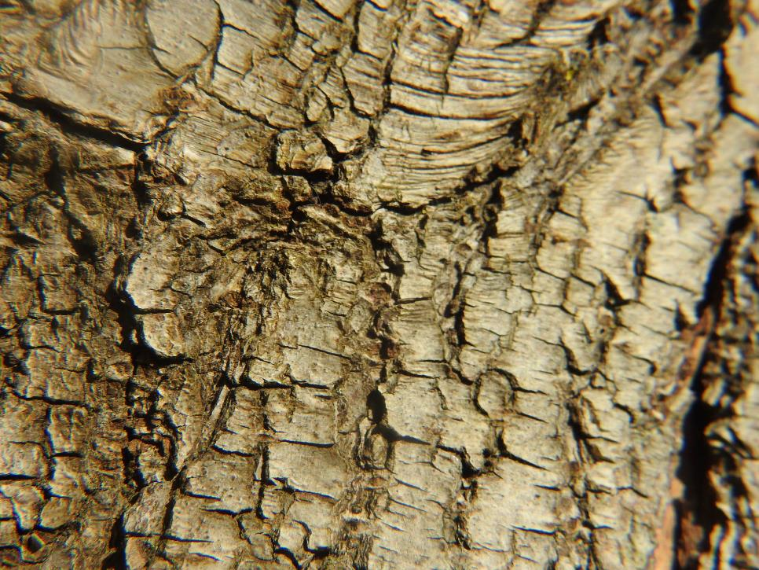
Online Meeting 23rd April
  Close-up Quiz (Items from the garden, by Mrs Akela)
Notes:
OK, so we’re going to play a cartoon character quiz, in a moment we’ll reveal a simplified image of some famous cartoon characters and we’d like you to put the answer into the chat. Are you ready> her goes…

Slide 2
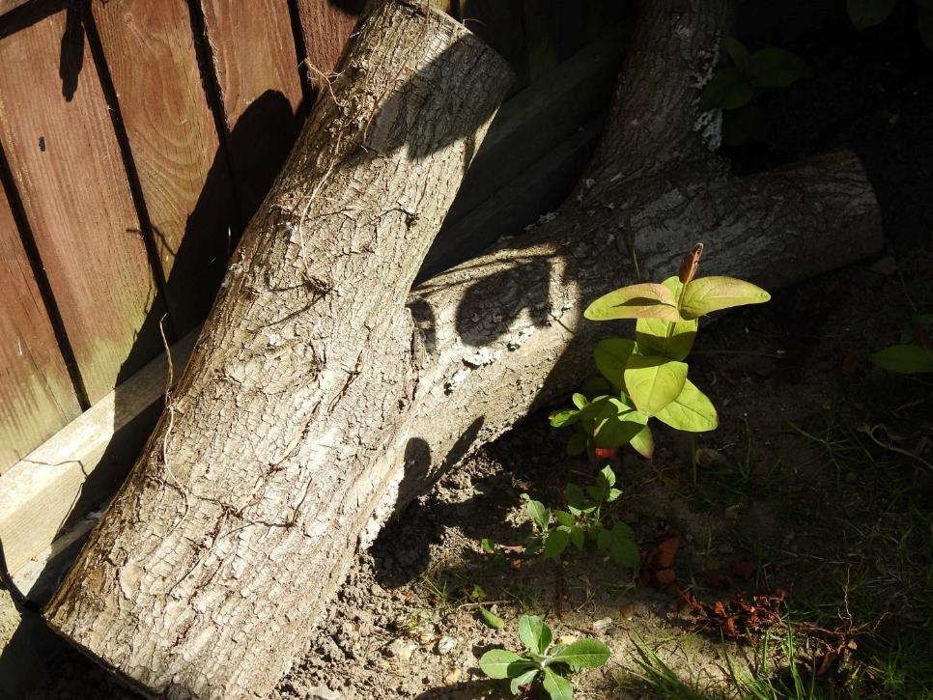
Online Meeting 23rd April
  Close-up Quiz (Items from the garden, by Mrs Akela)
A log
Notes:
OK, so we’re going to play a cartoon character quiz, in a moment we’ll reveal a simplified image of some famous cartoon characters and we’d like you to put the answer into the chat. Are you ready> her goes…

Slide 3
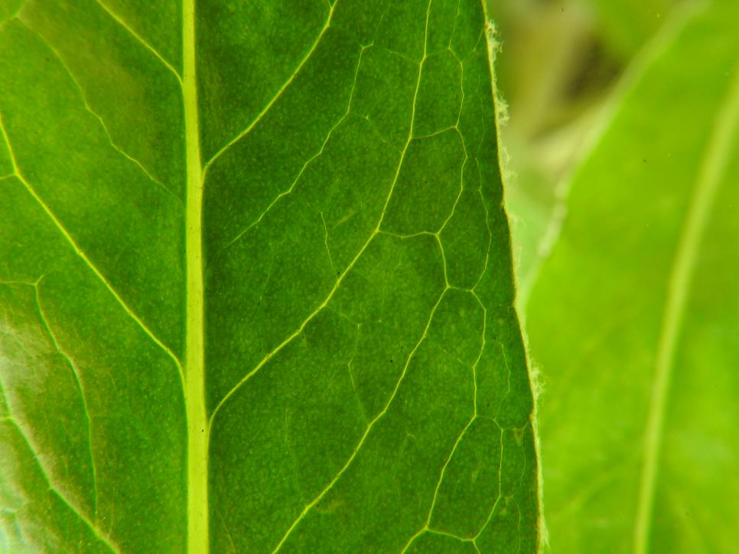
Online Meeting 23rd April
  Close-up Quiz (Items from the garden, by Mrs Akela)
Notes:
OK, so we’re going to play a cartoon character quiz, in a moment we’ll reveal a simplified image of some famous cartoon characters and we’d like you to put the answer into the chat. Are you ready> her goes…

Slide 4
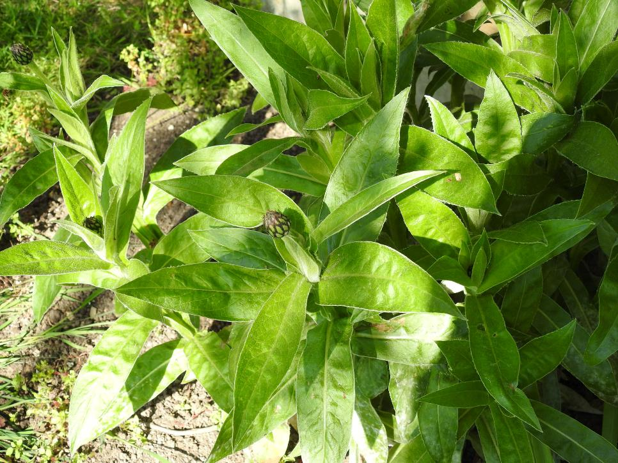
Online Meeting 23rd April
  Close-up Quiz (Items from the garden, by Mrs Akela)
A plant
Notes:
OK, so we’re going to play a cartoon character quiz, in a moment we’ll reveal a simplified image of some famous cartoon characters and we’d like you to put the answer into the chat. Are you ready> her goes…

Slide 5
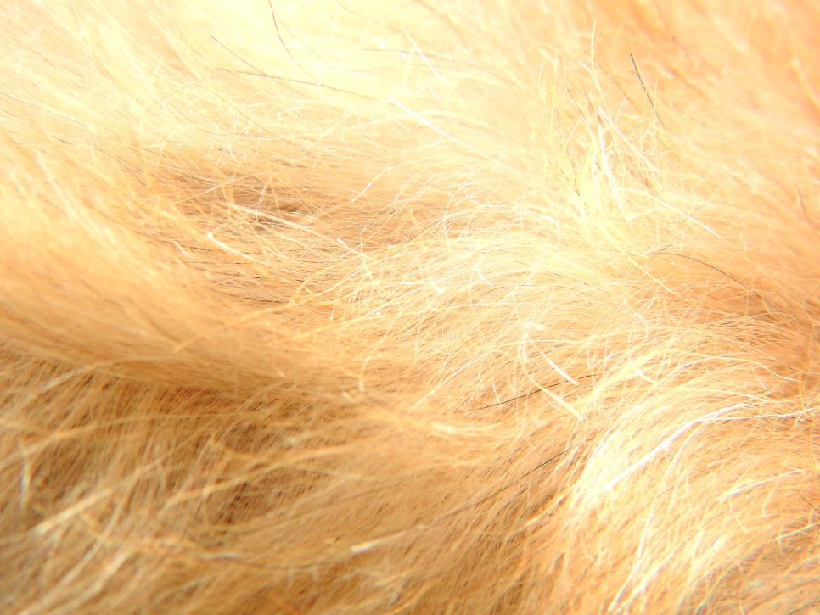
Online Meeting 23rd April
  Close-up Quiz (Items from the garden, by Mrs Akela)
Notes:
OK, so we’re going to play a cartoon character quiz, in a moment we’ll reveal a simplified image of some famous cartoon characters and we’d like you to put the answer into the chat. Are you ready> her goes…

Slide 6
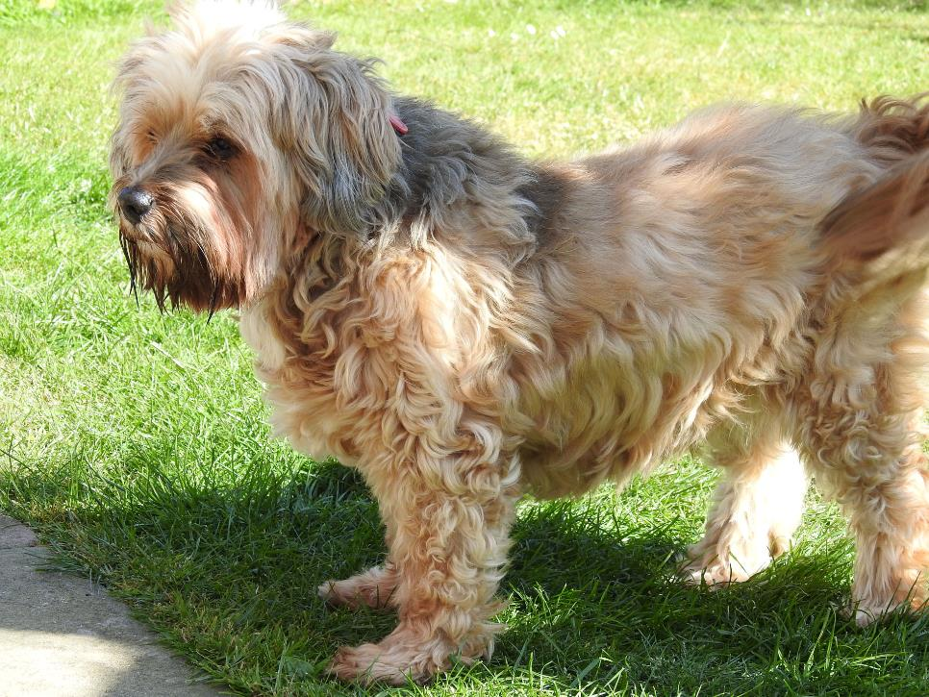
Online Meeting 23rd April
  Close-up Quiz (Items from the garden, by Mrs Akela)
A dog (Mollie)
Notes:
OK, so we’re going to play a cartoon character quiz, in a moment we’ll reveal a simplified image of some famous cartoon characters and we’d like you to put the answer into the chat. Are you ready> her goes…

Slide 7
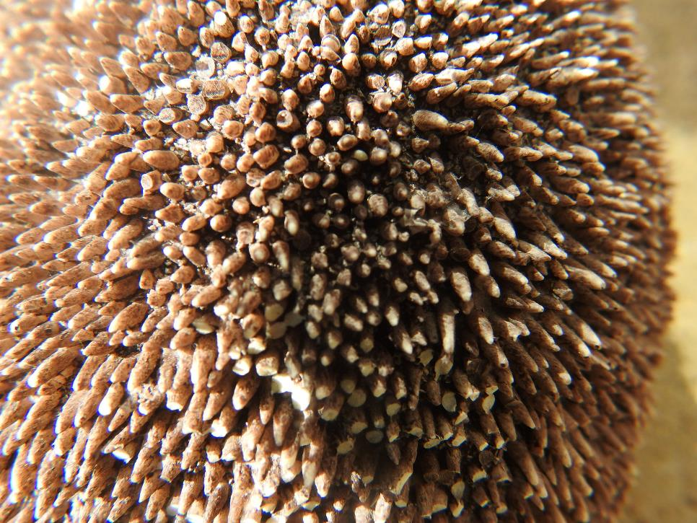
Online Meeting 23rd April
  Close-up Quiz (Items from the garden, by Mrs Akela)
Notes:
OK, so we’re going to play a cartoon character quiz, in a moment we’ll reveal a simplified image of some famous cartoon characters and we’d like you to put the answer into the chat. Are you ready> her goes…

Slide 8
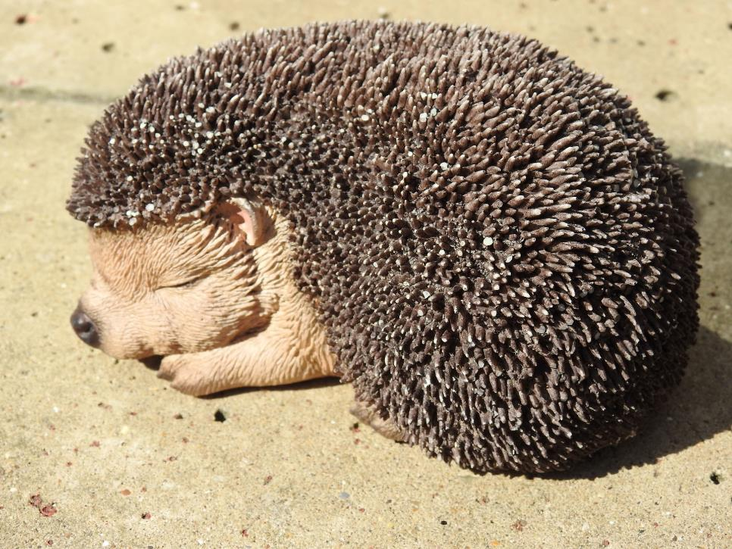
Online Meeting 23rd April
  Close-up Quiz (Items from the garden, by Mrs Akela)
A hedgehog
Notes:
OK, so we’re going to play a cartoon character quiz, in a moment we’ll reveal a simplified image of some famous cartoon characters and we’d like you to put the answer into the chat. Are you ready> her goes…

Slide 9

Online Meeting 23rd April
  Close-up Quiz (Items from the garden, by Mrs Akela)
Notes:
OK, so we’re going to play a cartoon character quiz, in a moment we’ll reveal a simplified image of some famous cartoon characters and we’d like you to put the answer into the chat. Are you ready> her goes…

Slide 10
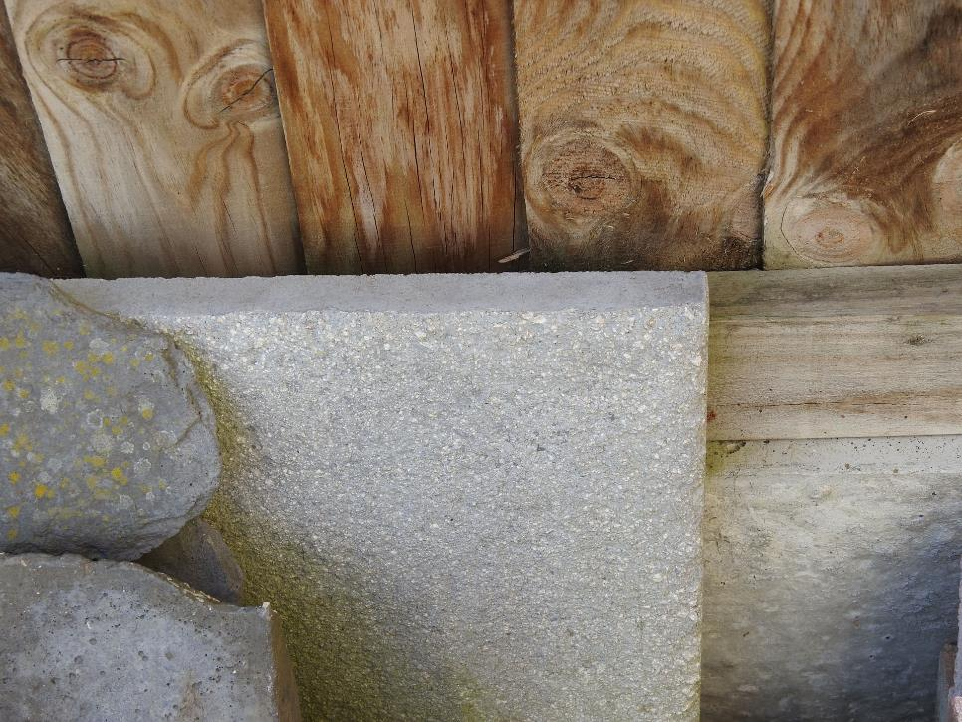
Online Meeting 23rd April
  Close-up Quiz (Items from the garden, by Mrs Akela)
A paving slab
Notes:
OK, so we’re going to play a cartoon character quiz, in a moment we’ll reveal a simplified image of some famous cartoon characters and we’d like you to put the answer into the chat. Are you ready> her goes…

Slide 11
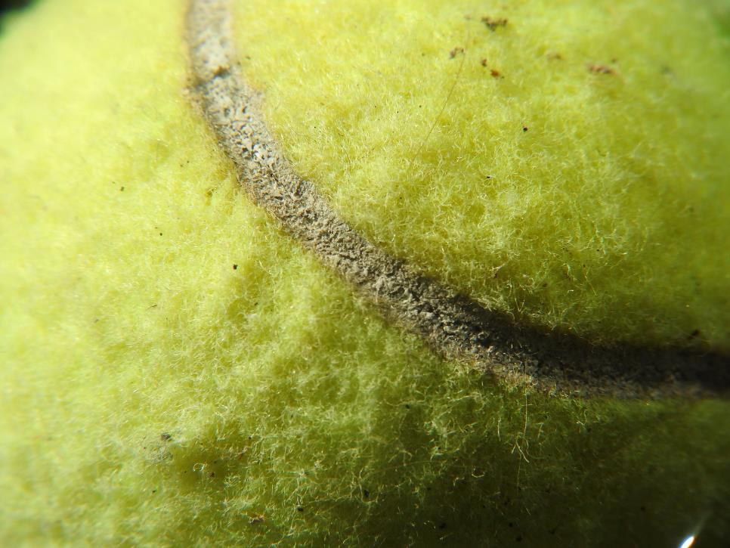
Online Meeting 23rd April
  Close-up Quiz (Items from the garden, by Mrs Akela)
Notes:
OK, so we’re going to play a cartoon character quiz, in a moment we’ll reveal a simplified image of some famous cartoon characters and we’d like you to put the answer into the chat. Are you ready> her goes…

Slide 12
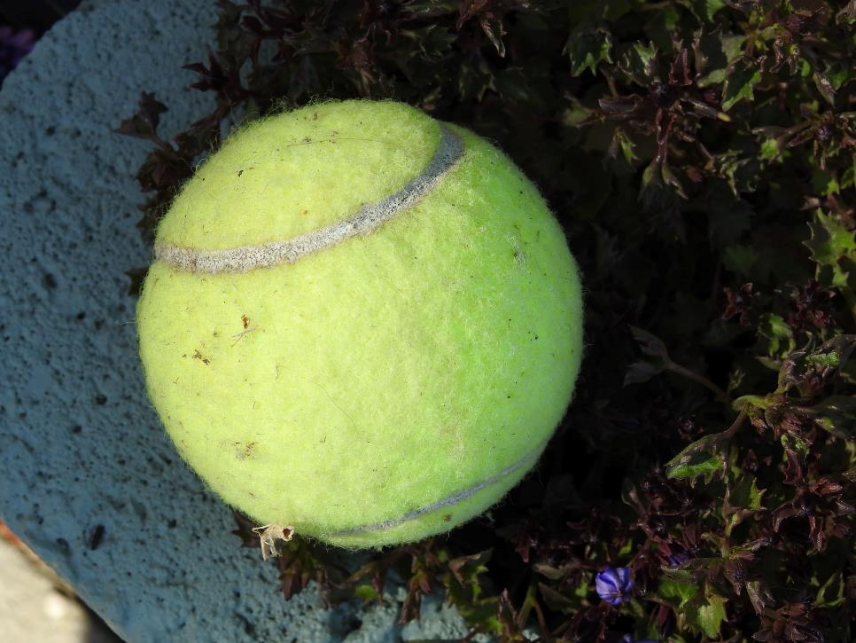
Online Meeting 23rd April
  Close-up Quiz (Items from the garden, by Mrs Akela)
A tennis ball
Notes:
OK, so we’re going to play a cartoon character quiz, in a moment we’ll reveal a simplified image of some famous cartoon characters and we’d like you to put the answer into the chat. Are you ready> her goes…

Slide 13
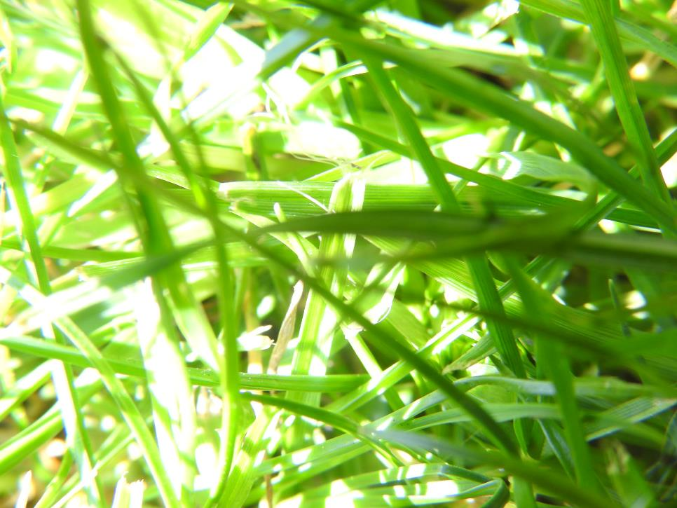
Online Meeting 23rd April
  Close-up Quiz (Items from the garden, by Mrs Akela)
Notes:
OK, so we’re going to play a cartoon character quiz, in a moment we’ll reveal a simplified image of some famous cartoon characters and we’d like you to put the answer into the chat. Are you ready> her goes…

Slide 14
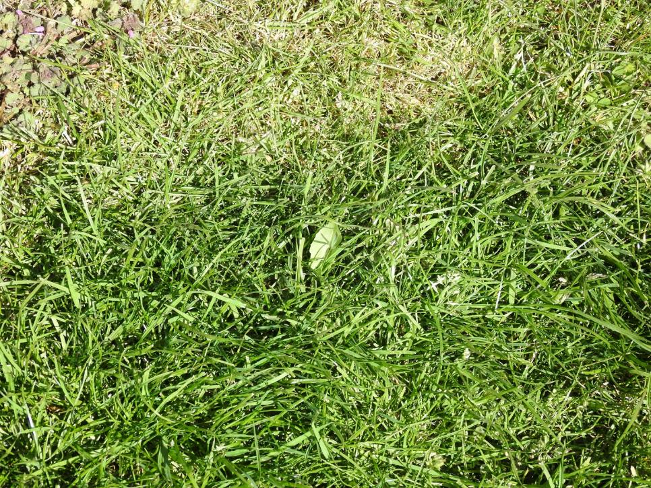
Online Meeting 23rd April
  Close-up Quiz (Items from the garden, by Mrs Akela)
Grass
Notes:
OK, so we’re going to play a cartoon character quiz, in a moment we’ll reveal a simplified image of some famous cartoon characters and we’d like you to put the answer into the chat. Are you ready> her goes…

Slide 15
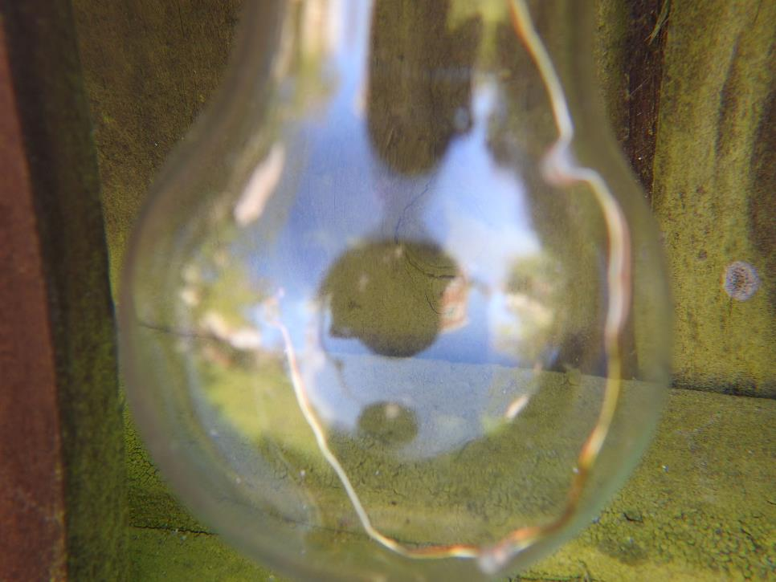
Online Meeting 23rd April
  Close-up Quiz (Items from the garden, by Mrs Akela)
Notes:
OK, so we’re going to play a cartoon character quiz, in a moment we’ll reveal a simplified image of some famous cartoon characters and we’d like you to put the answer into the chat. Are you ready> her goes…

Slide 16
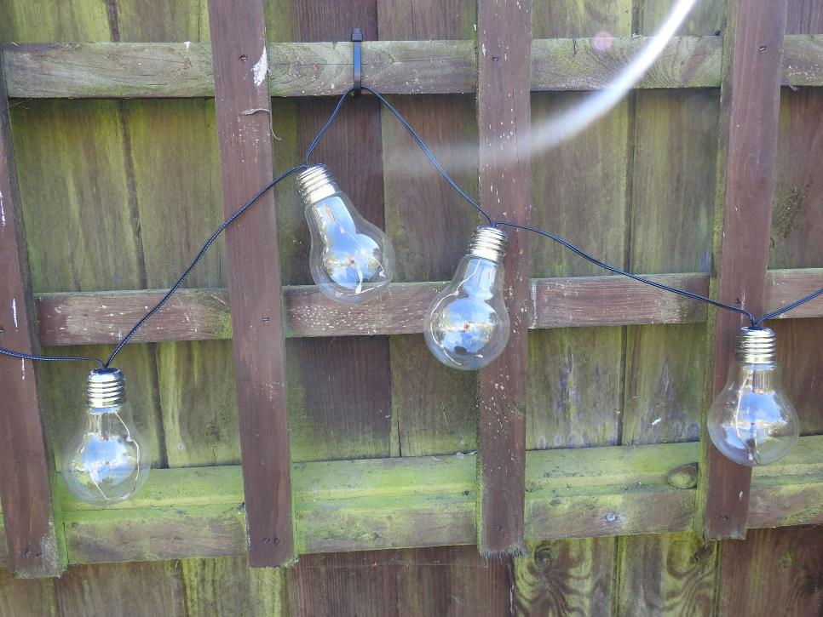
Online Meeting 23rd April
  Close-up Quiz (Items from the garden, by Mrs Akela)
Garden Lights
Notes:
OK, so we’re going to play a cartoon character quiz, in a moment we’ll reveal a simplified image of some famous cartoon characters and we’d like you to put the answer into the chat. Are you ready> her goes…

Slide 17
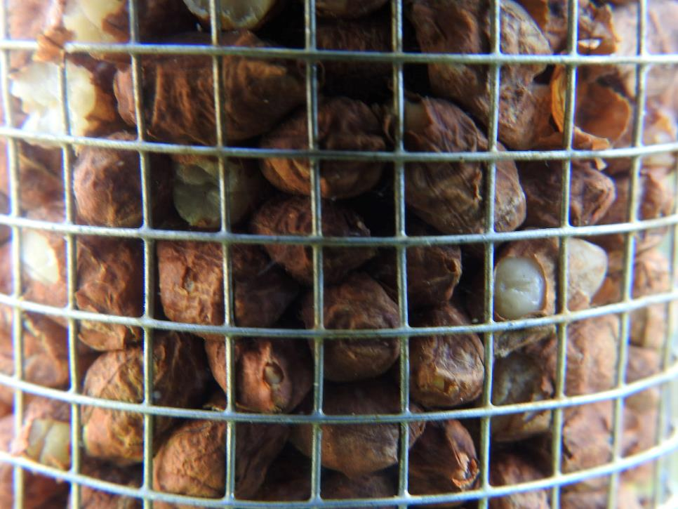
Online Meeting 23rd April
  Close-up Quiz (Items from the garden, by Mrs Akela)
Notes:
OK, so we’re going to play a cartoon character quiz, in a moment we’ll reveal a simplified image of some famous cartoon characters and we’d like you to put the answer into the chat. Are you ready> her goes…

Slide 18
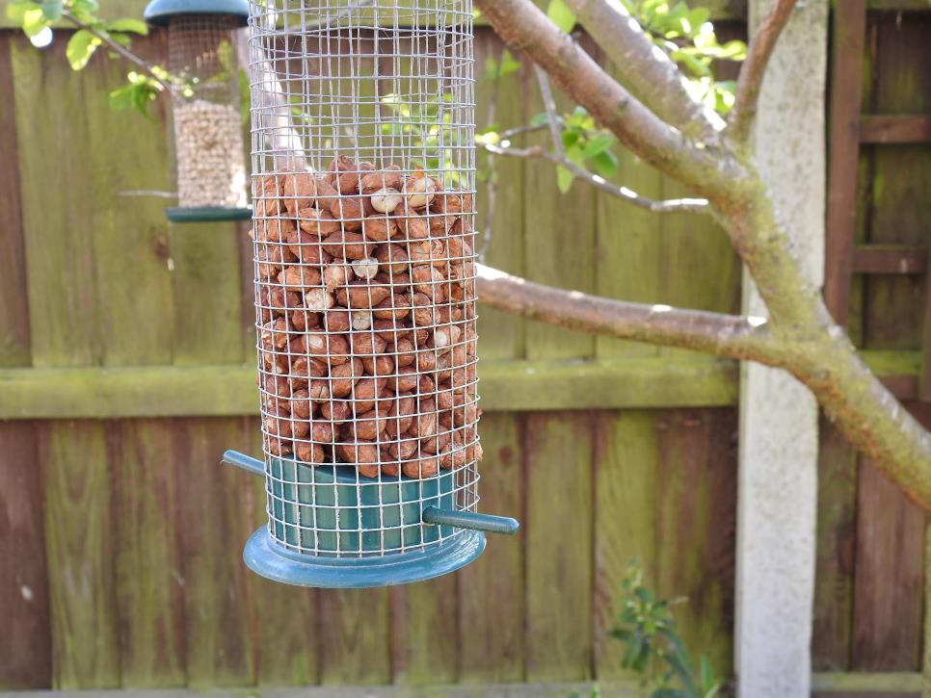
Online Meeting 23rd April
  Close-up Quiz (Items from the garden, by Mrs Akela)
Bird feeder
Notes:
OK, so we’re going to play a cartoon character quiz, in a moment we’ll reveal a simplified image of some famous cartoon characters and we’d like you to put the answer into the chat. Are you ready> her goes…

Slide 19
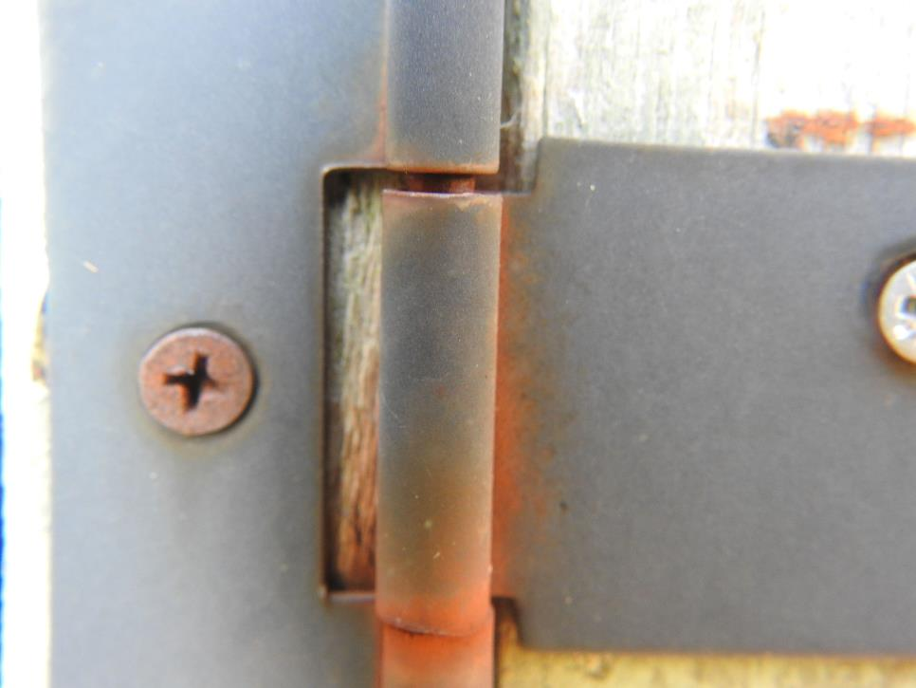
Online Meeting 23rd April
  Close-up Quiz (Items from the garden, by Mrs Akela)
Notes:
OK, so we’re going to play a cartoon character quiz, in a moment we’ll reveal a simplified image of some famous cartoon characters and we’d like you to put the answer into the chat. Are you ready> her goes…

Slide 20
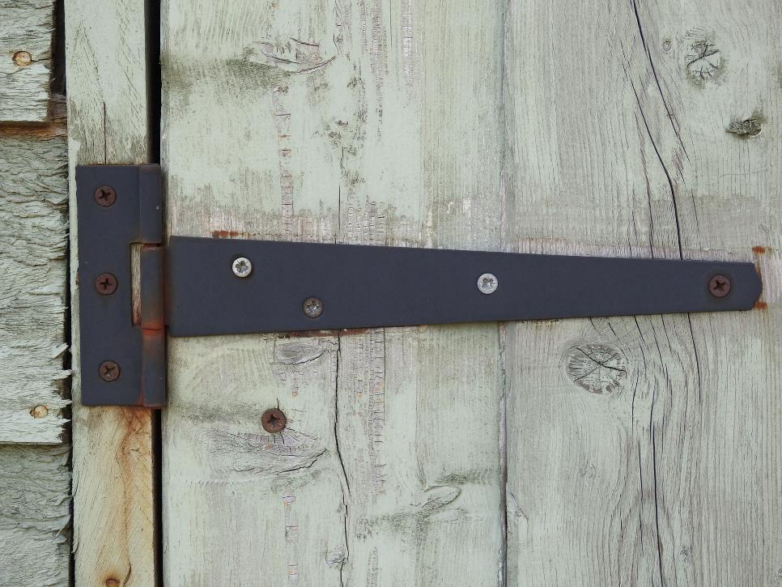
Online Meeting 23rd April
  Close-up Quiz (Items from the garden, by Mrs Akela)
Shed Door / hinge
Notes:
OK, so we’re going to play a cartoon character quiz, in a moment we’ll reveal a simplified image of some famous cartoon characters and we’d like you to put the answer into the chat. Are you ready> her goes…

