Slide 1

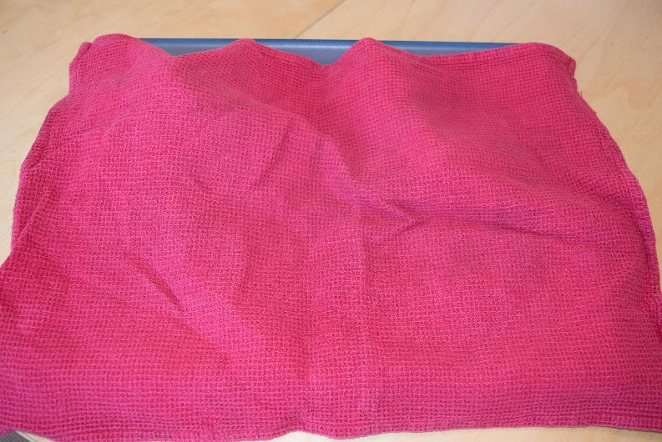
Weekly Meeting 26th March
  Kim’s Game…
Notes:
OK, so we’re going to play “Kim’s Game”, it’s a game from back when Scouting started and comes from a book called Kim about a boy who trains as a spy.
This is a covered tray, under here are 15 items…

Slide 2
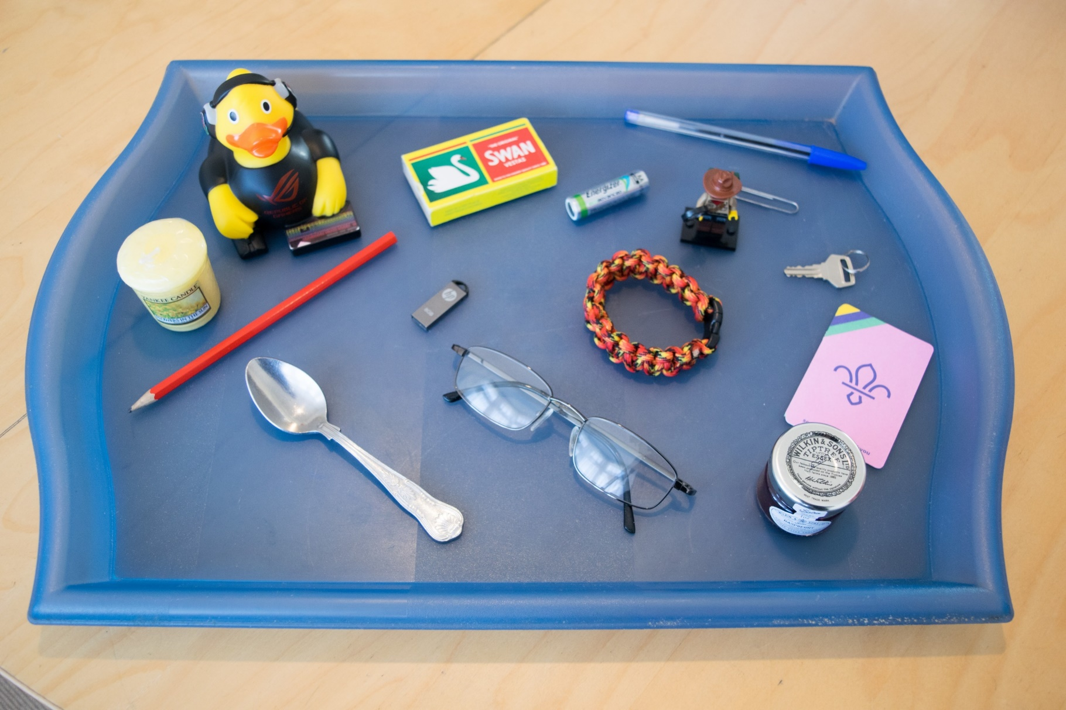
Weekly Meeting 26th March
  Kim’s Game…
Notes:
Look at the picture, here are the 15 objects on the tray, we will cover the tray and then take one item away.
Candle, Duck, Pencil, Matches, AA battery, Pen, Paper Clip, Lego Figure, Key, Paracord Bracelet, USB Drive, Teaspoon, Glasses, Scout Card, Jam

Slide 3
Weekly Meeting 26th March
  Kim’s Game…

Slide 4
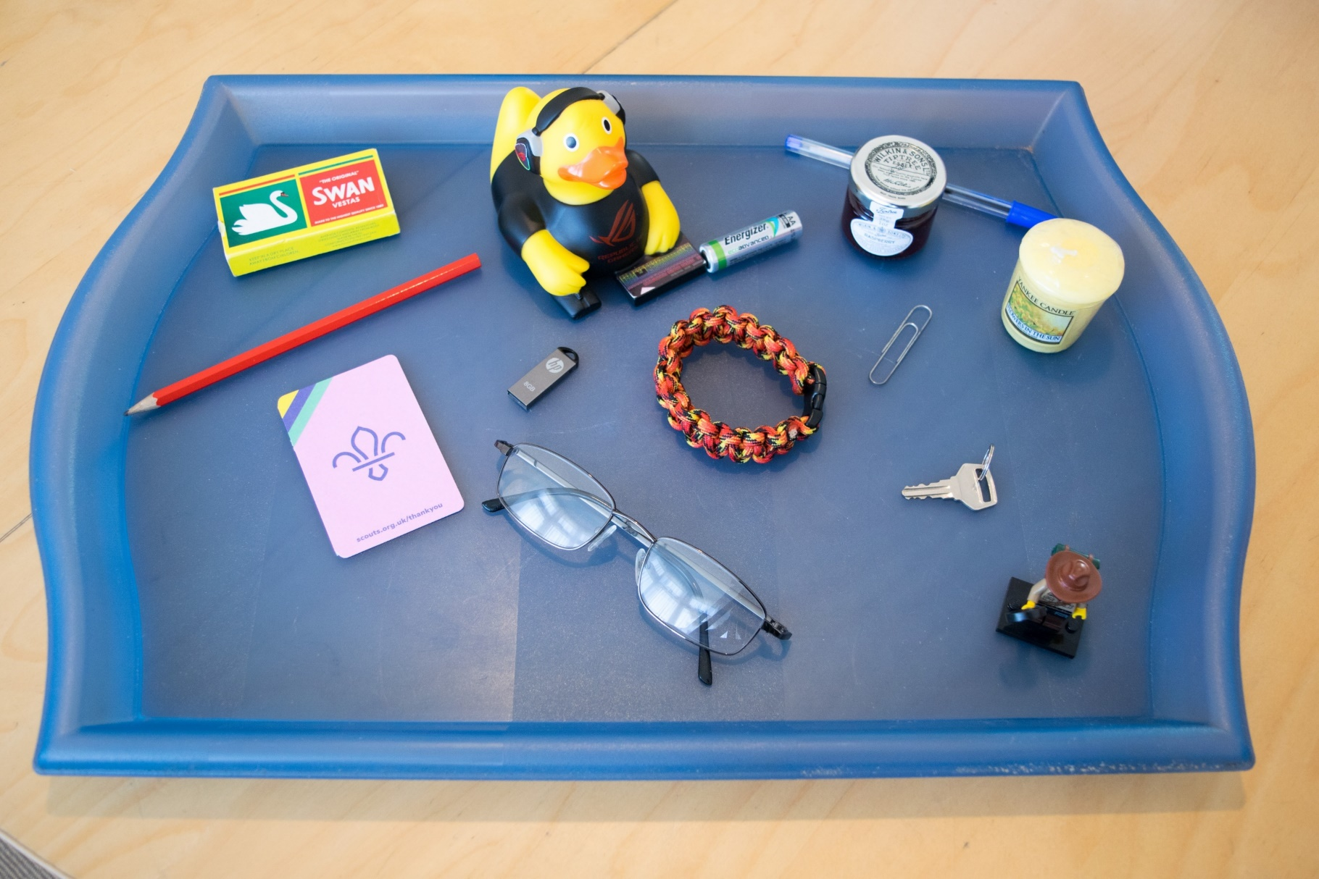
Weekly Meeting 26th March
  Kim’s Game…
Notes:
Teaspoon

Slide 5
Weekly Meeting 26th March
  Kim’s Game…

Slide 6
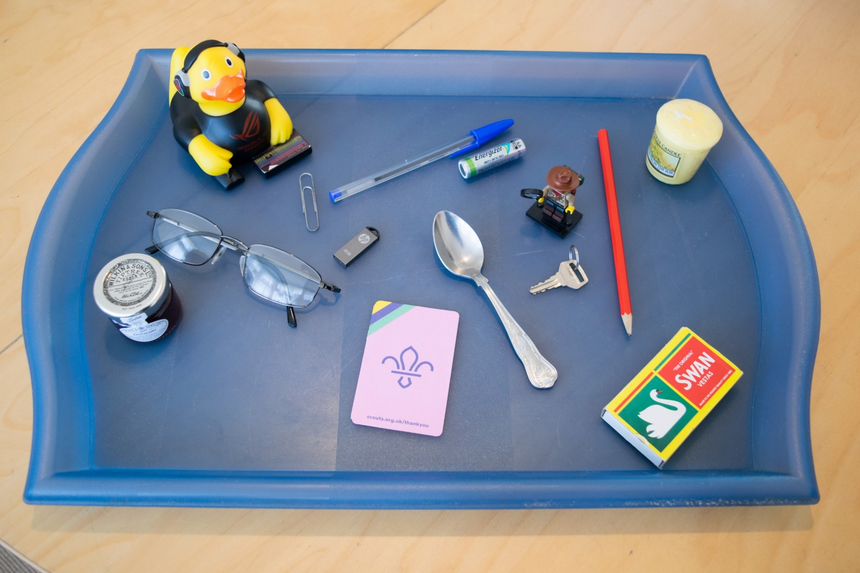
Weekly Meeting 26th March
  Kim’s Game…
Notes:
That’s right it’s the paracord bracelet…

Slide 7
Weekly Meeting 26th March
  Kim’s Game…

Slide 8
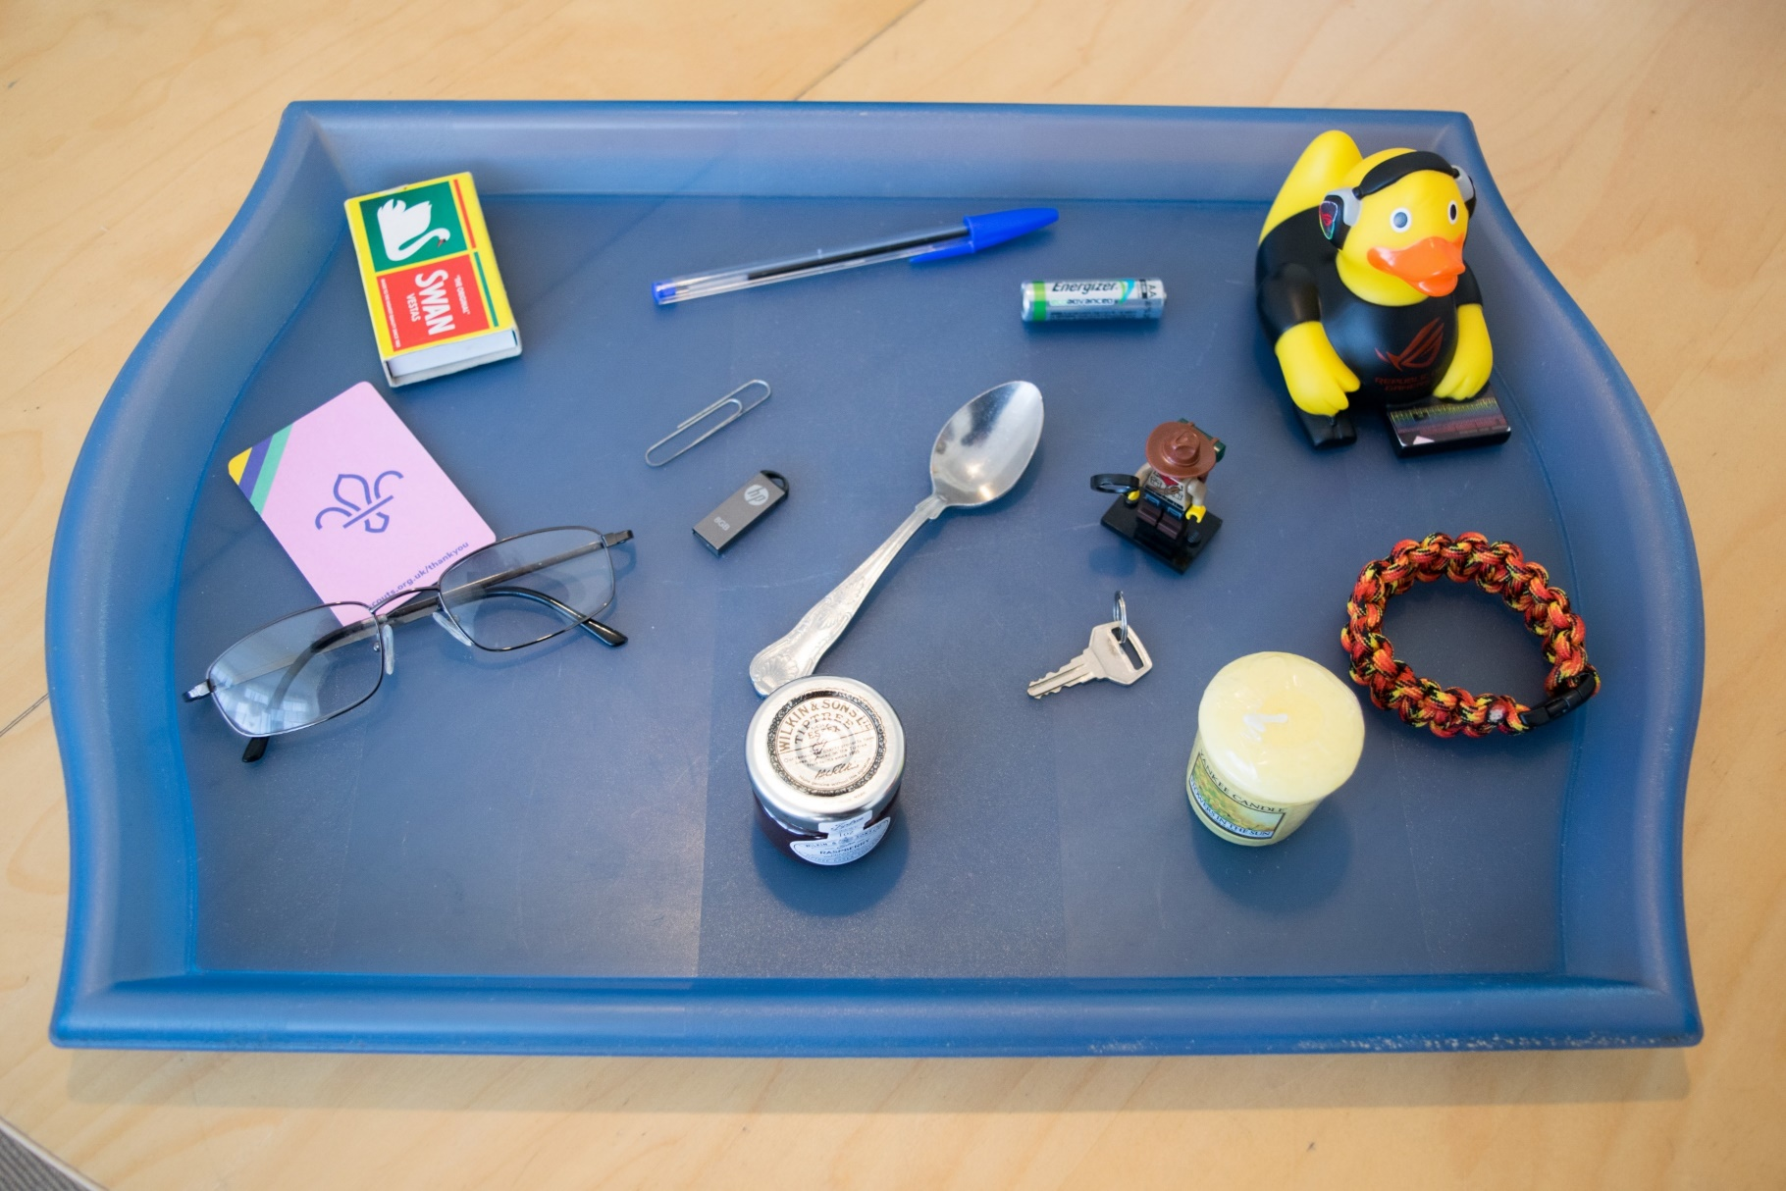
Weekly Meeting 26th March
  Kim’s Game…
Notes:
That’s right it’s the pencil, well done

Slide 9
Weekly Meeting 26th March
  Kim’s Game…

Slide 10
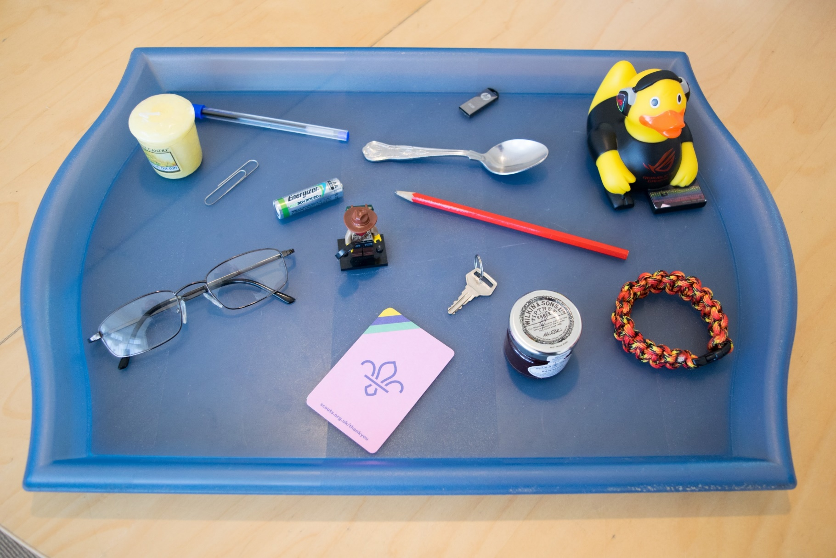
Weekly Meeting 26th March
  Kim’s Game…
Notes:
That’s right it’s the matches, well done….

Slide 11
Weekly Meeting 26th March
  Kim’s Game…

Slide 12
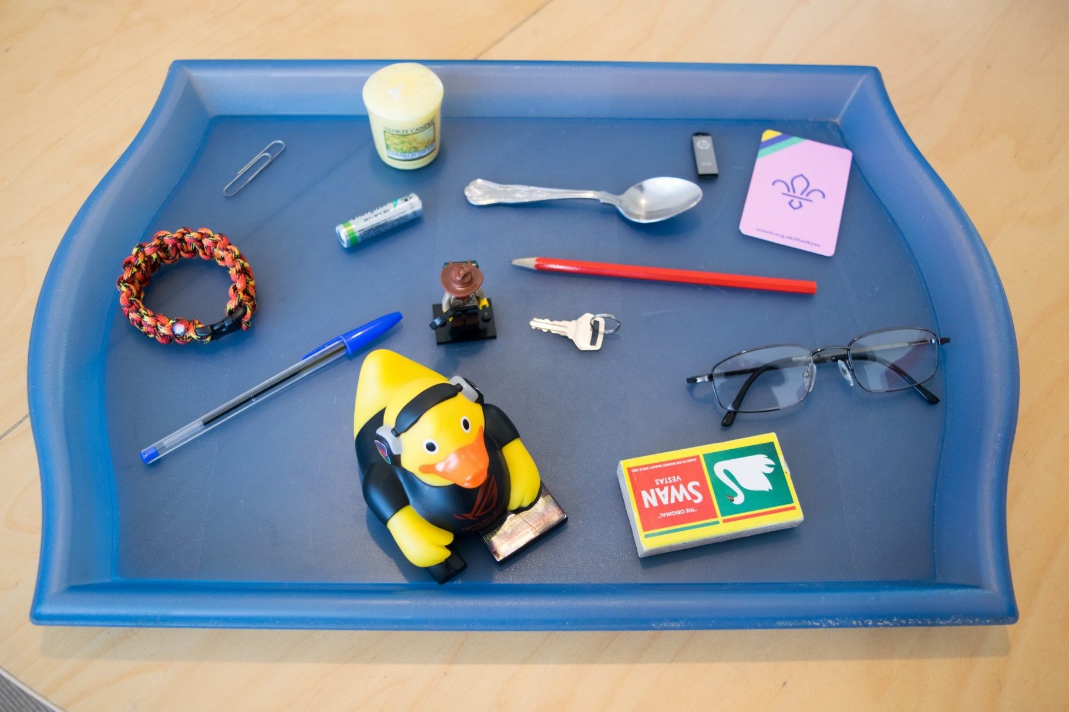
Weekly Meeting 26th March
  Kim’s Game…
Notes:
Jar of Jam

Slide 13
Weekly Meeting 26th March
  Kim’s Game…

Slide 14
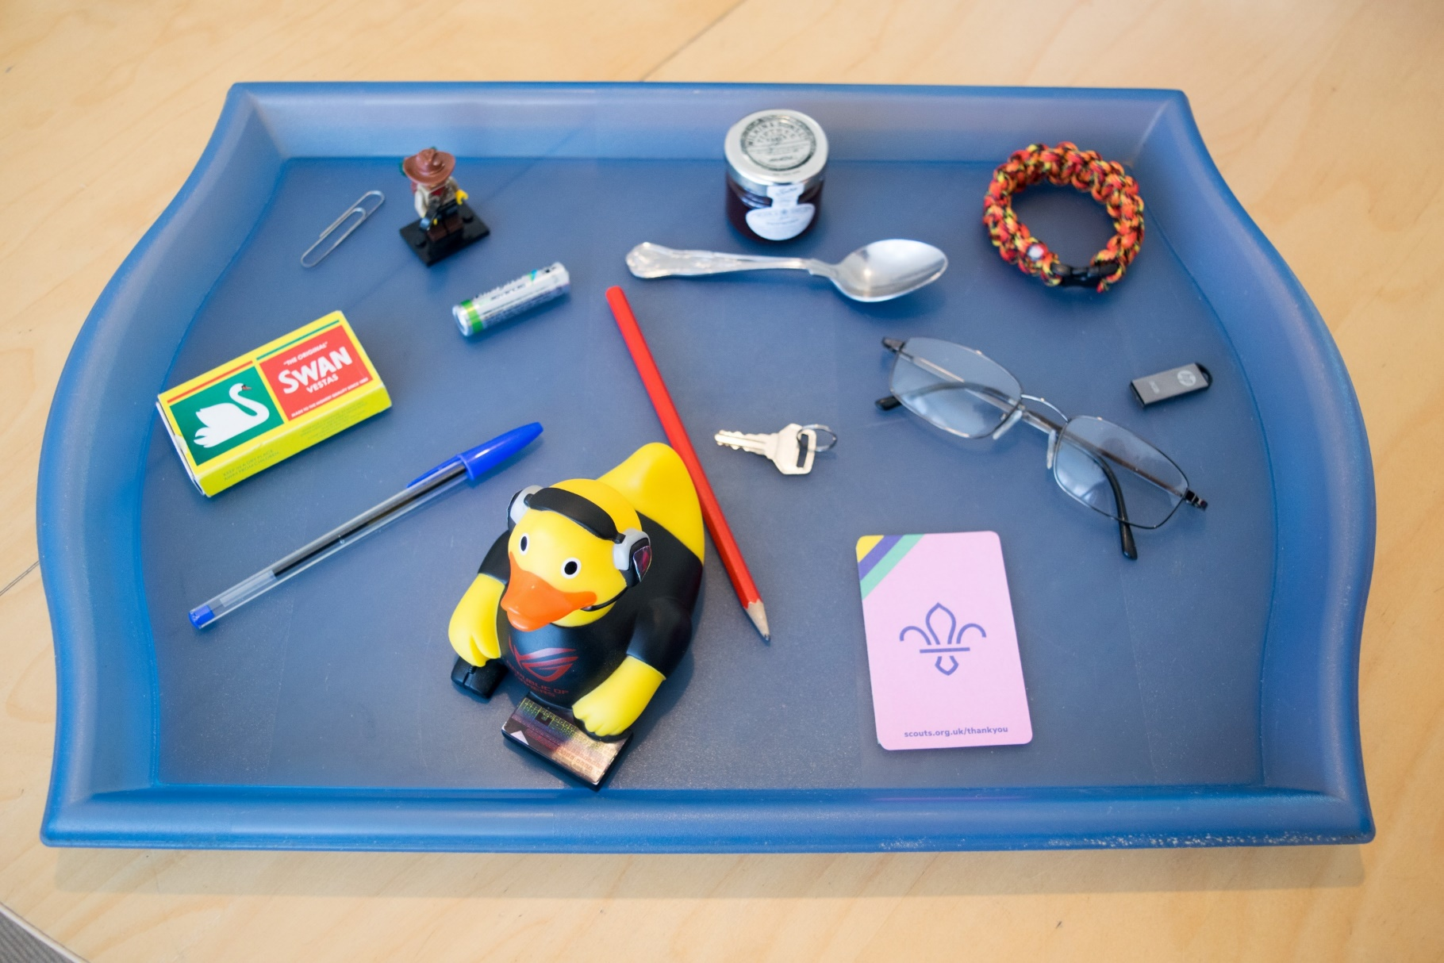
Weekly Meeting 26th March
  Kim’s Game…
Notes:
That’s right it’s the candle

Slide 15
Weekly Meeting 26th March
  Kim’s Game…

Slide 16
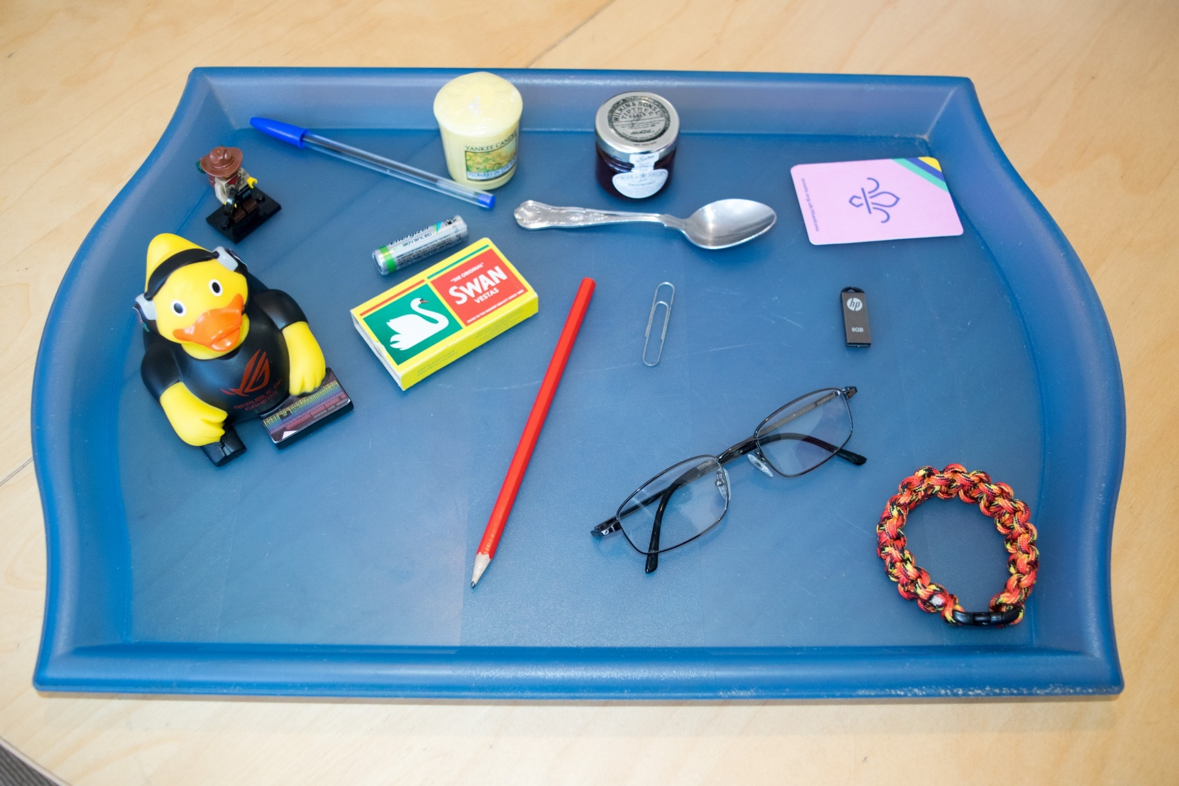
Weekly Meeting 26th March
  Kim’s Game…
Notes:
Key

Slide 17
Weekly Meeting 26th March
  Kim’s Game…

Slide 18
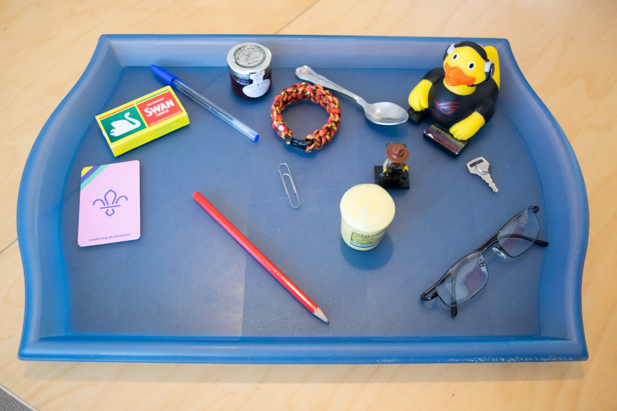
Weekly Meeting 26th March
  Kim’s Game…
Notes:
That’s right it’s the battery and the USB stick, well done all….

Slide 19
Weekly Meeting 26th March
  Kim’s Game…

Slide 20
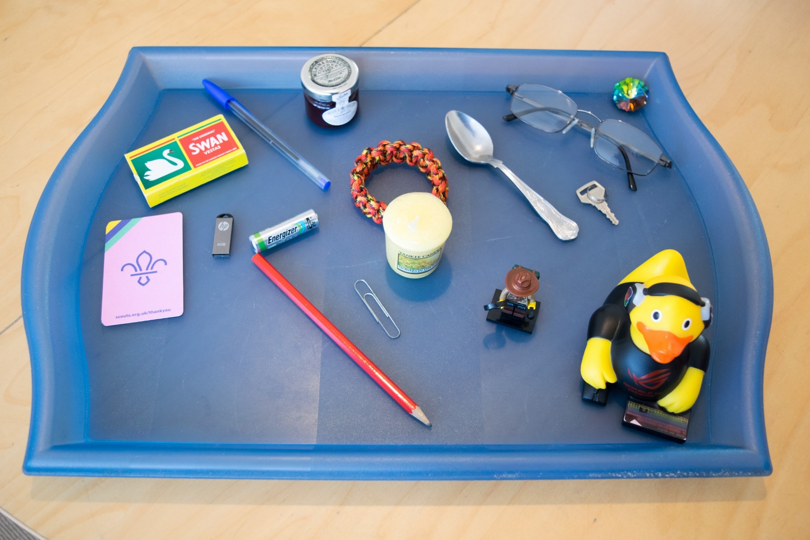
Weekly Meeting 26th March
  Kim’s Game…
Notes:
One additional item this time a crystal (top right corner)

