Slide 1
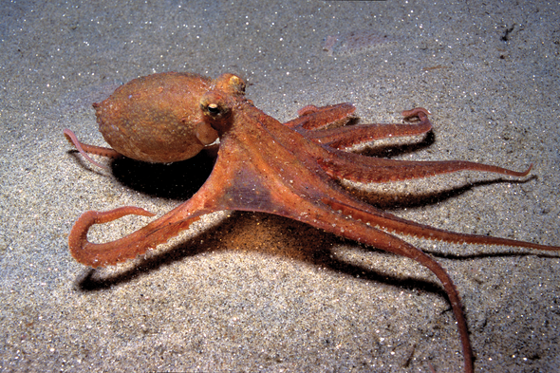
Online Meeting 11th June
  Animal Quiz
  Question 1
How many tentacles does an octopus have?
Eight

Slide 2
Online Meeting 11th June
  Animal Quiz
  Question 1
How many tentacles
does an octopus have?
Eight

Slide 3
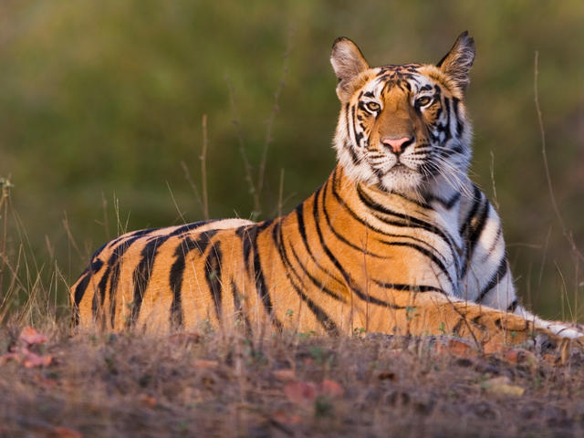
Online Meeting 11th June
  Animal Quiz
  Question 2
What is the largest big cat in the world?
Tiger

Slide 4
Online Meeting 11th June
  Animal Quiz
  Question 2
What is the largest big cat in the world?
Tiger

Slide 5
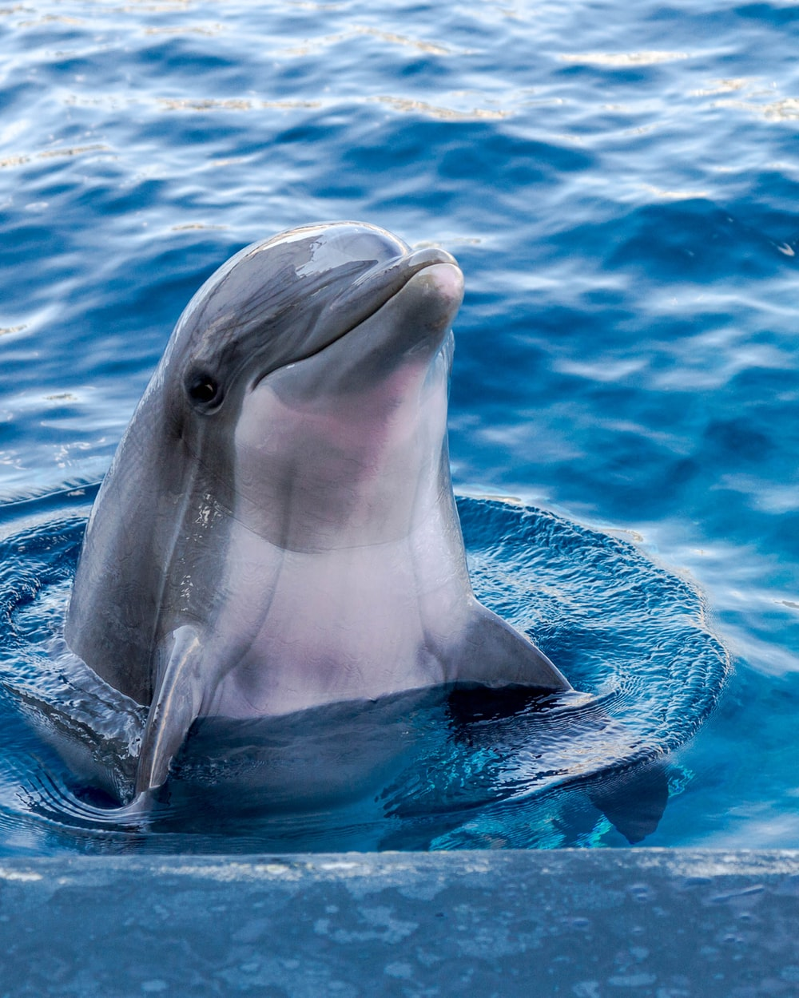
Online Meeting 11th June
  Animal Quiz
  Question 3
Yes or no?
Is a dolphin a mammal?
Yes
(they give birth to live young)

Slide 6
Online Meeting 11th June
  Animal Quiz
  Question 3
Yes or no?
Is a dolphin a mammal?
Yes
(they give birth to live young)

Slide 7
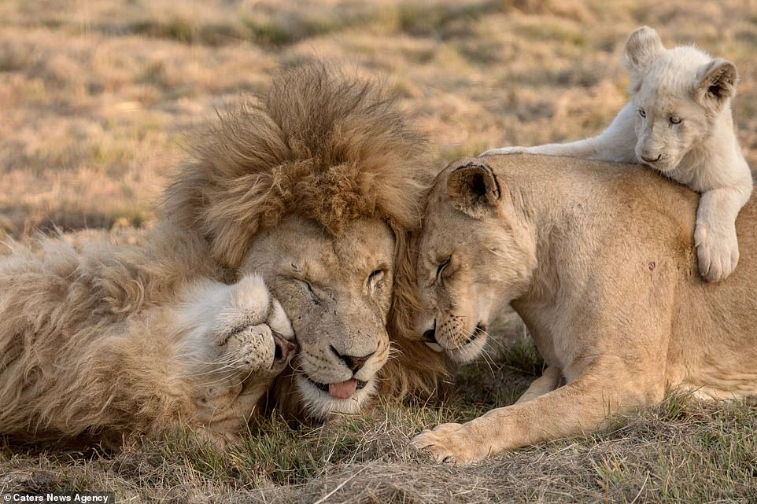
Online Meeting 11th June
  Animal Quiz
  Question 4
What is a group of lions called?
A pride

Slide 8
Online Meeting 11th June
  Animal Quiz
  Question 4
What is a group of lions called?
A pride

Slide 9
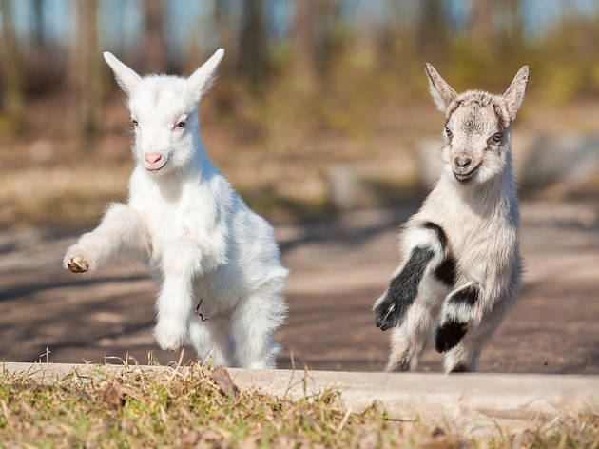
Online Meeting 11th June
  Animal Quiz
  Question 5
What are baby goats called?
Kids

Slide 10
Online Meeting 11th June
  Animal Quiz
  Question 5
What are baby goats called?
Kids

Slide 11
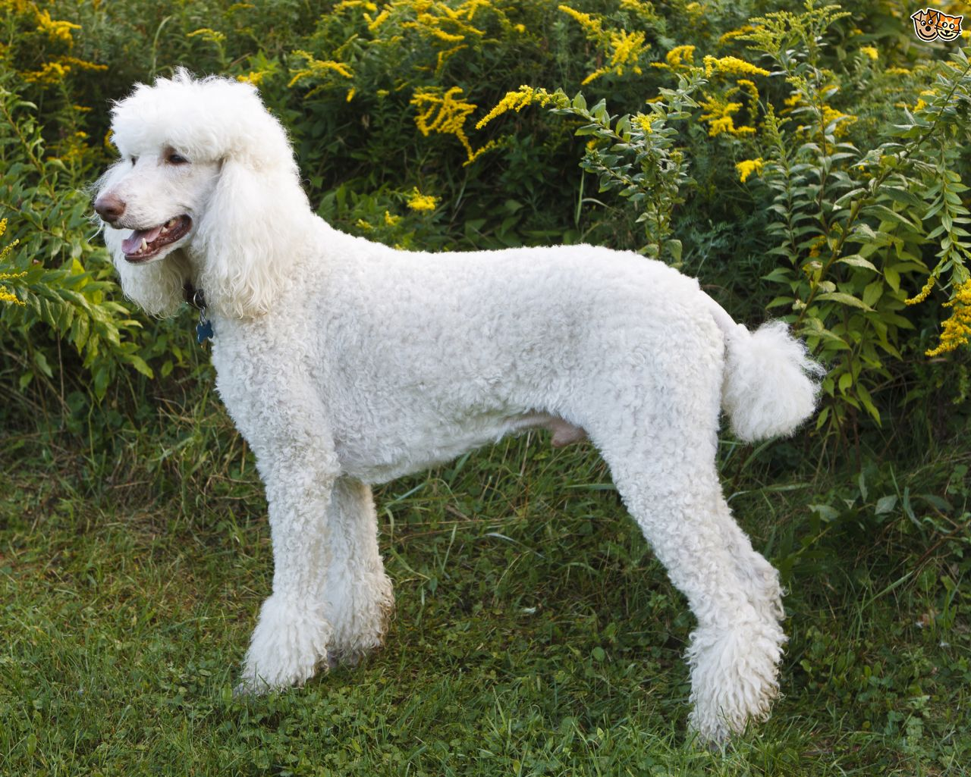
Online Meeting 11th June
  Animal Quiz
  Question 6
What type of animal is a poodle?
A dog

Slide 12
Online Meeting 11th June
  Animal Quiz
  Question 6
What type of animal is a poodle?
A dog

Slide 13
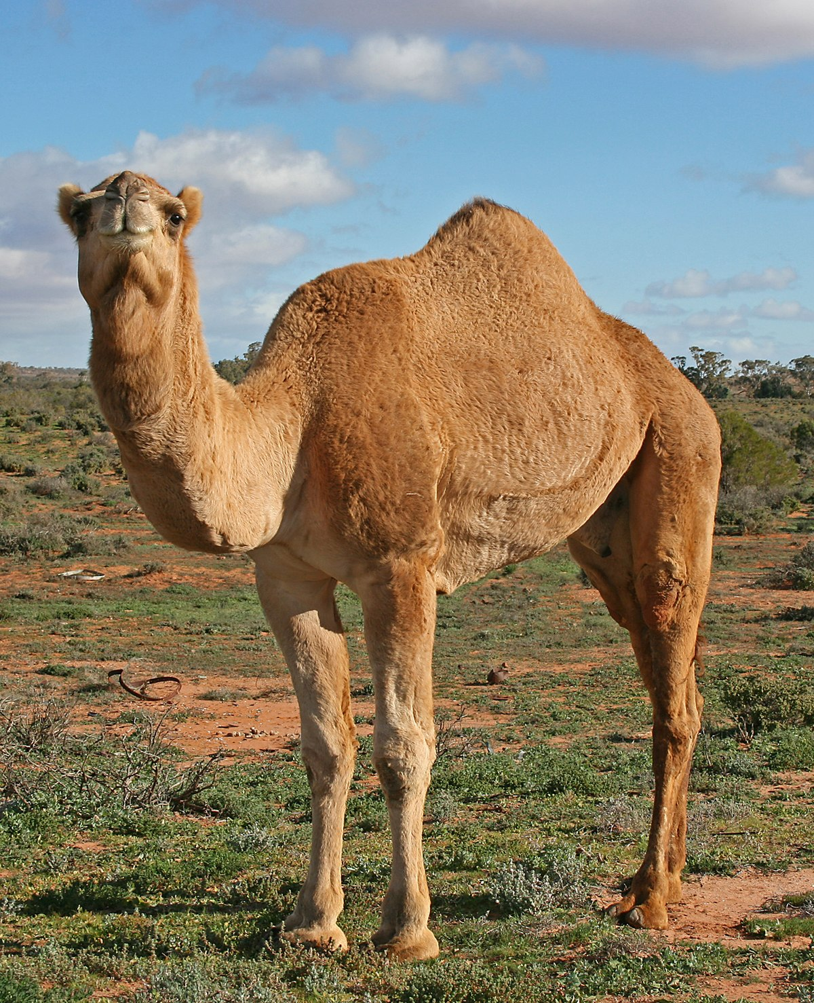
Online Meeting 11th June
  Animal Quiz
  Question 7
What do camels store in their humps?
Fat

Slide 14
Online Meeting 11th June
  Animal Quiz
  Question 7
What do camels store in their humps?
Fat

Slide 15
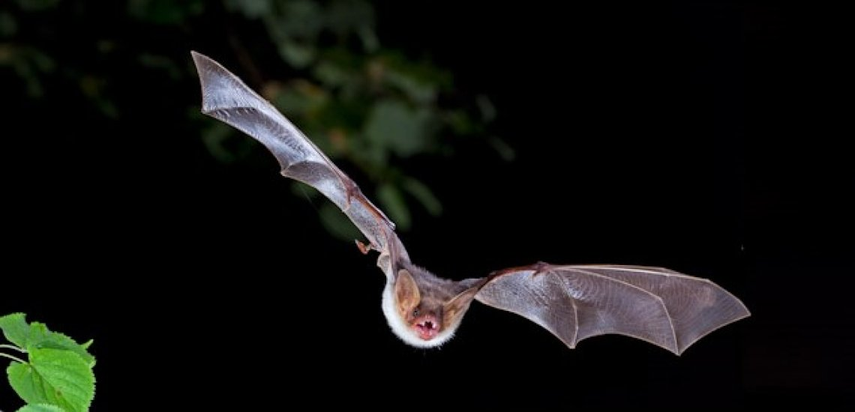
Online Meeting 11th June
  Animal Quiz
  Question 8
What is the only mammal that can fly?
A bat

Slide 16
Online Meeting 11th June
  Animal Quiz
  Question 8
What is the only mammal that can fly?
A bat

Slide 17
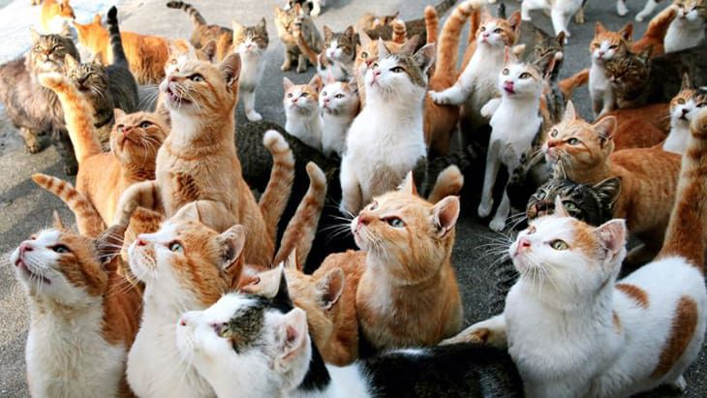
Online Meeting 11th June
  Animal Quiz
  Question 9
The word feline relates to what mammal?
Cats

Slide 18
Online Meeting 11th June
  Animal Quiz
  Question 9
The word feline relates to what mammal?
Cats

Slide 19
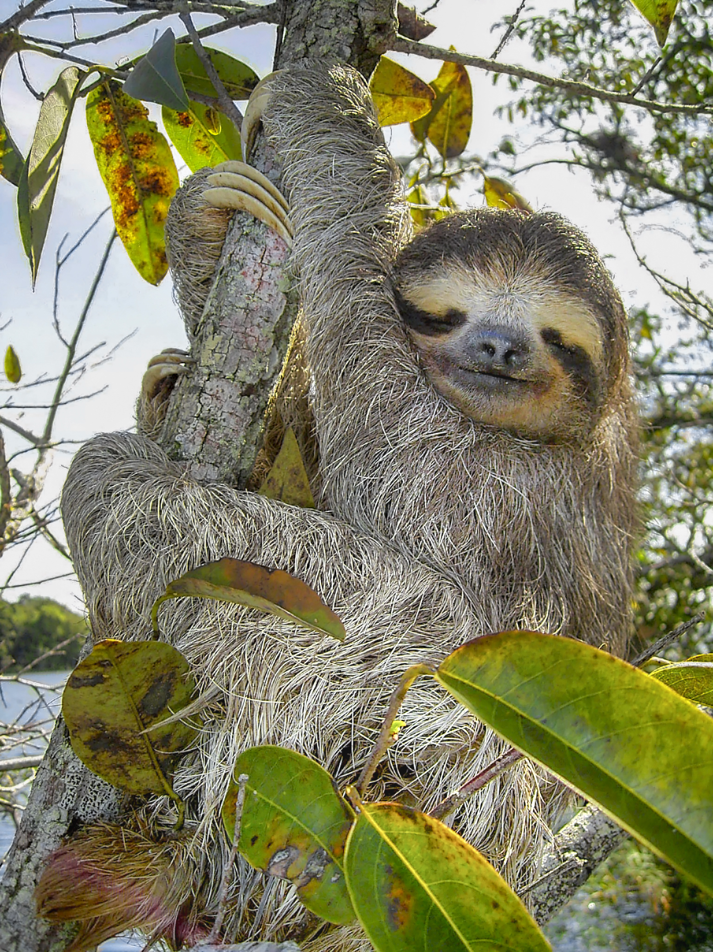
Online Meeting 11th June
  Animal Quiz
  Question 10
What is the slowest animal in the world?
Three-toed sloth
Notes:
Average speed of 0.15mph

Slide 20
Online Meeting 11th June
  Animal Quiz
  Question 10
What is the slowest animal in the world?
Three-toed sloth
Notes:
Average speed of 0.15mph

