Slide 1
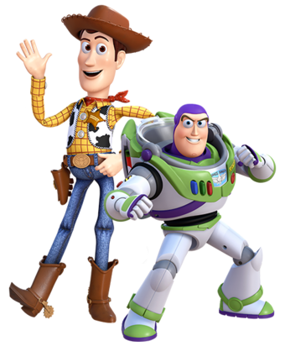
Online Meeting 2nd July
  Entertainment Quiz
  Question 1
Sheriff Woody Pride and Buzz Lightyear are main characters in which films?
Toy Story

Slide 2
Online Meeting 2nd July
  Entertainment Quiz
  Question 1
Sheriff Woody Pride and Buzz Lightyear are main characters in which films?
Toy Story

Slide 3
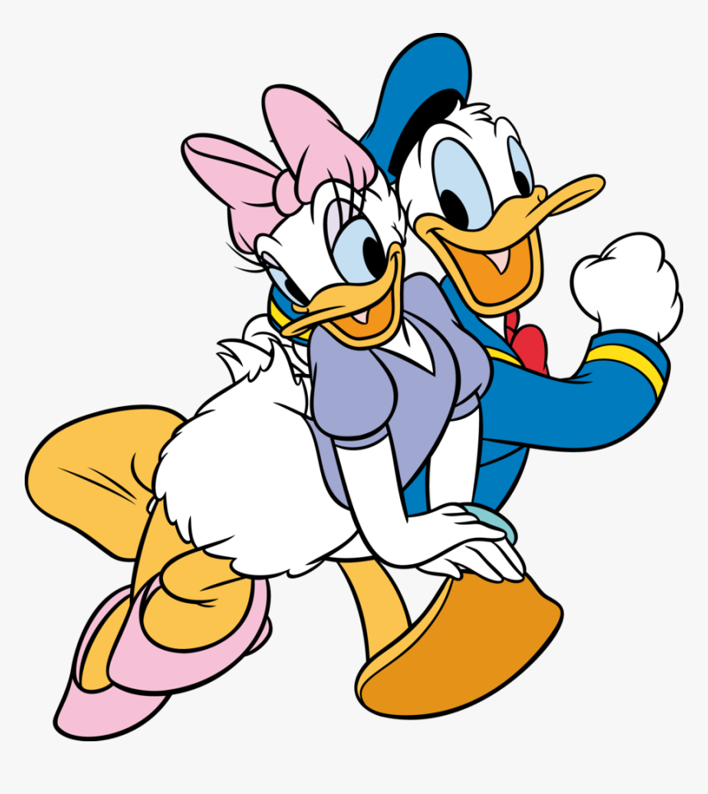
Online Meeting 2nd July
  Entertainment Quiz
  Question 2
What is the name of Donald Duck’s girlfriend?
Daisy

Slide 4
Online Meeting 2nd July
  Entertainment Quiz
  Question 2
What is the name of Donald Duck’s girlfriend?
Daisy

Slide 5
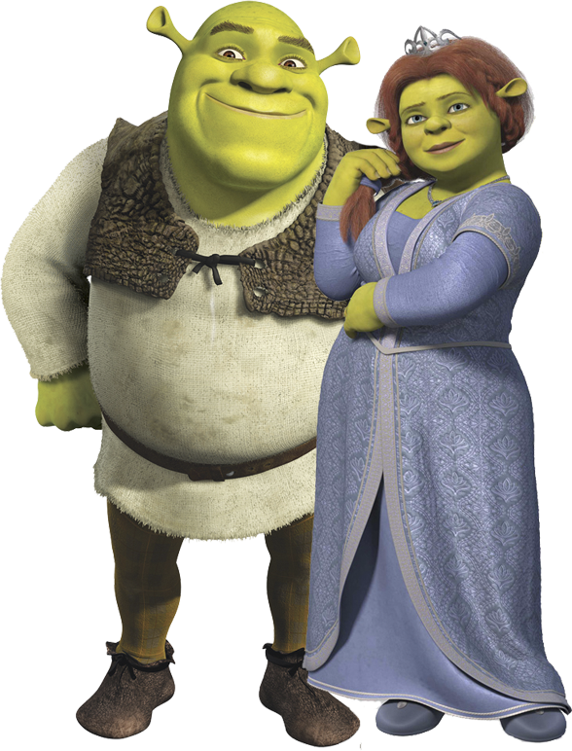
Online Meeting 2nd July
  Entertainment Quiz
  Question 3
What is the name of Shrek’s wife?
(Princess) Fiona

Slide 6
Online Meeting 2nd July
  Entertainment Quiz
  Question 3
What is the name of Shrek’s wife?
(Princess) Fiona

Slide 7
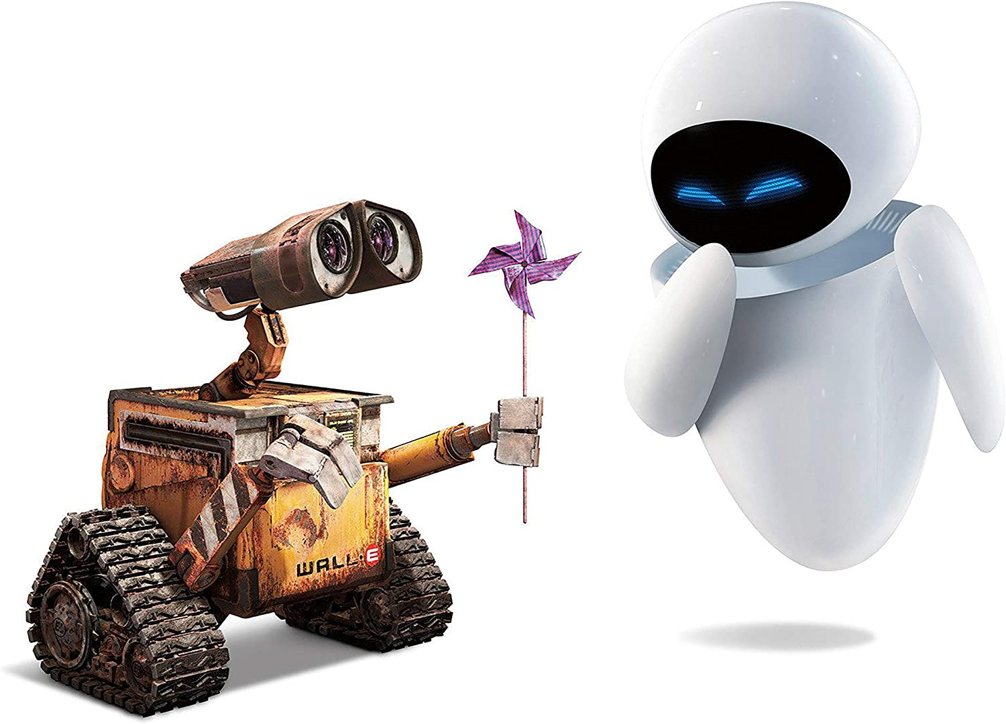
Online Meeting 2nd July
  Entertainment Quiz
  Question 4
Who fell in love with a robot called EVE?
Wall-E

Slide 8
Online Meeting 2nd July
  Entertainment Quiz
  Question 4
Who fell in love with a robot called EVE?
Wall-E

Slide 9

Online Meeting 2nd July
  Entertainment Quiz
  Question 5
Which children's tv program shares its name with a naval flag?

Slide 10

Online Meeting 2nd July
  Entertainment Quiz
  Question 5
Which children's tv program shares its name with a naval flag?
“Ready to sail”

Slide 11
Online Meeting 2nd July
  Entertainment Quiz
  Question 5
Which children's tv program shares its name with a naval flag?
“Ready to sail”

Slide 12
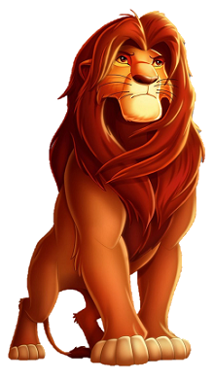
Online Meeting 2nd July
  Entertainment Quiz
  Question 6
What is the name of the hero in ‘The Lion King’ ?
Simba

Slide 13
Online Meeting 2nd July
  Entertainment Quiz
  Question 6
What is the name of the hero in ‘The Lion King’ ?
Simba

Slide 14
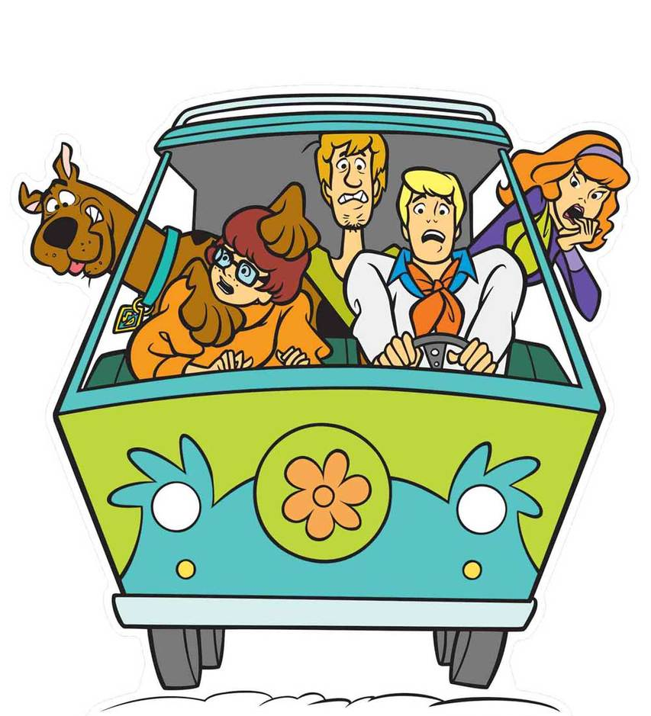
Online Meeting 2nd July
  Entertainment Quiz
  Question 7
What is the name of the vehicle Scooby Doo and his friends travel in?
The Mystery Machine

Slide 15
Online Meeting 2nd July
  Entertainment Quiz
  Question 7
What is the name of the vehicle Scooby Doo and his friends travel in?
The Mystery Machine

Slide 16
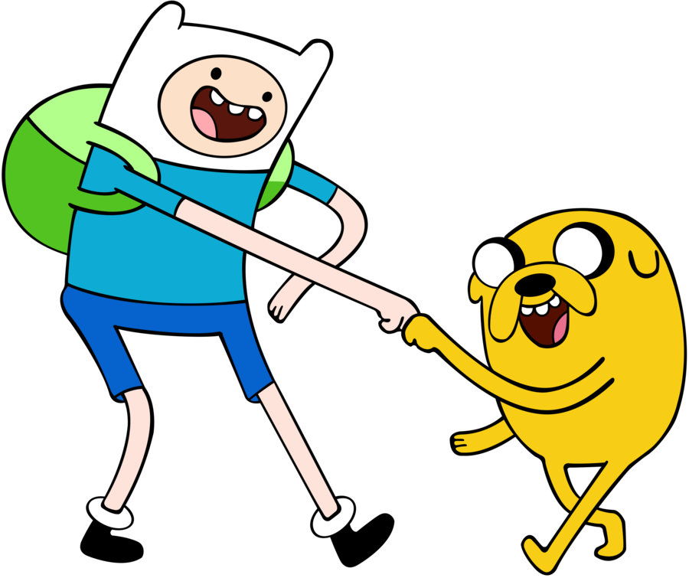
Online Meeting 2nd July
  Entertainment Quiz
  Question 8
What are the names of the boy and dog in Adventure Time?
Finn & Jake

Slide 17
Online Meeting 2nd July
  Entertainment Quiz
  Question 8
What are the names of the boy and dog in Adventure Time?
Finn & Jake

Slide 18

Online Meeting 2nd July
  Entertainment Quiz
  Question 9
Who lives in a pineapple under the sea?
SpongeBob SquarePants

Slide 19
Online Meeting 2nd July
  Entertainment Quiz
  Question 9
Who lives in a pineapple under the sea?
SpongeBob SquarePants

Slide 20
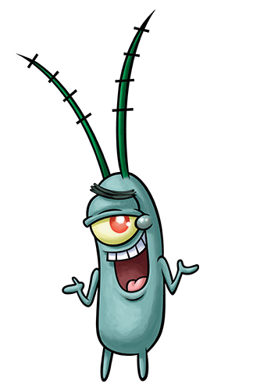
Online Meeting 2nd July
  Entertainment Quiz
  Question 10
Who is always trying to steal Krabby Patties?
(Sheldon J.) Plankton

Slide 21
Online Meeting 2nd July
  Entertainment Quiz
  Question 10
Who is always trying to steal Krabby Patties?
(Sheldon J.) Plankton

