Slide 1
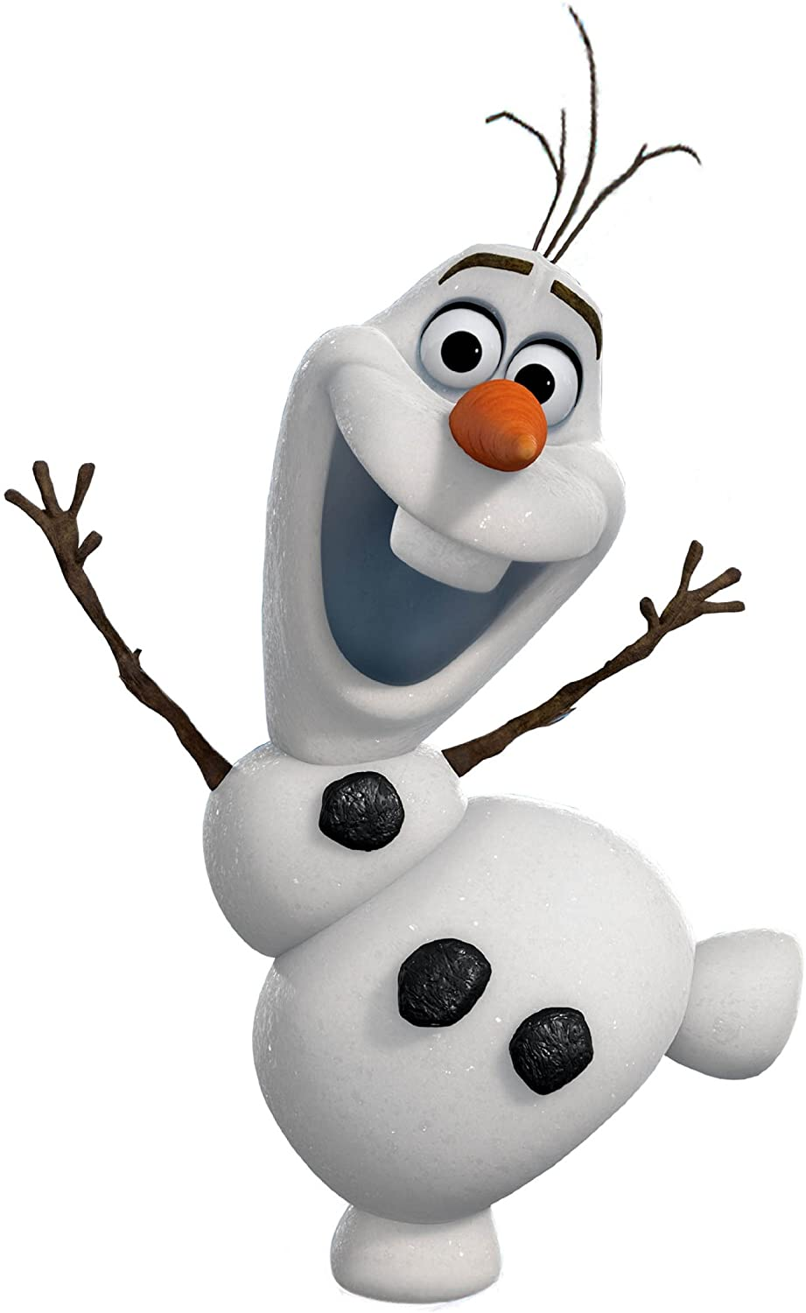
Online Meeting 9th July
Entertainment Quiz
Question 1
What is the name of the snowman in Frozen?
Olaf

Slide 2
Online Meeting 9th July
Entertainment Quiz
Question 1
What is the name of the snowman in Frozen?
Olaf

Slide 3
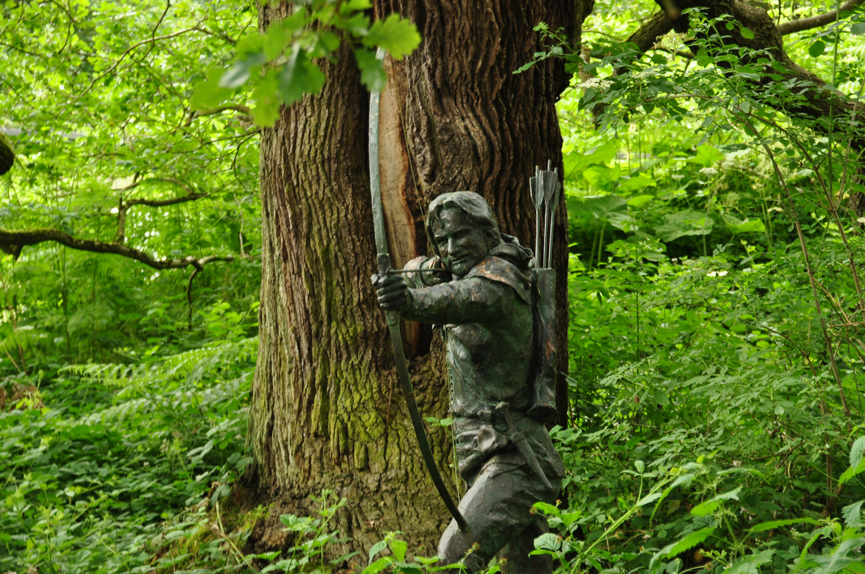
Online Meeting 9th July
Entertainment Quiz
Question 2
In which forest does Robin Hood live?
Sherwood

Slide 4
Online Meeting 9th July
Entertainment Quiz
Question 2
In which forest does Robin Hood live?
Sherwood

Slide 5

Online Meeting 9th July
Entertainment Quiz
Question 3
What sort of animal is the video game character Sonic?
Hedgehog

Slide 6
Online Meeting 9th July
Entertainment Quiz
Question 3
What sort of animal is the video game character Sonic?
Hedgehog

Slide 7
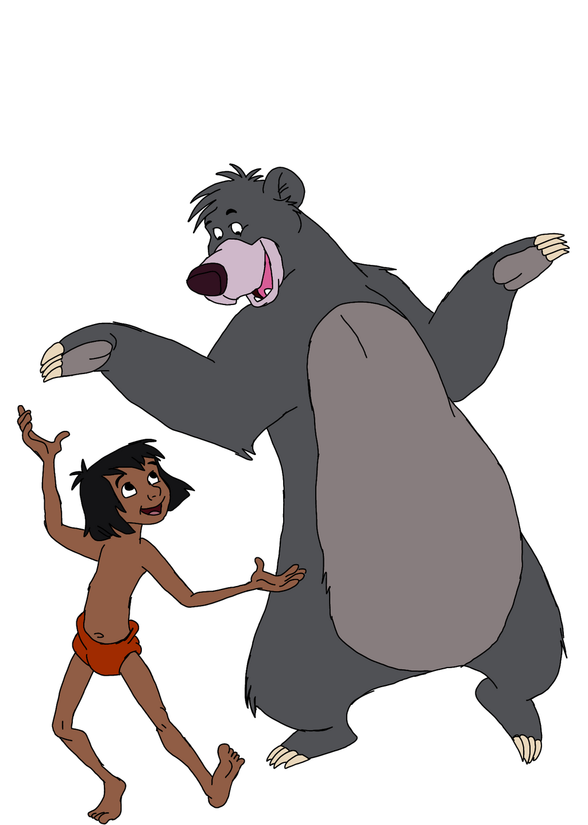
Online Meeting 9th July
Entertainment Quiz
Question 4
In ‘The Jungle Book’ what kind of animal is Baloo?
A Bear

Slide 8
Online Meeting 9th July
Entertainment Quiz
Question 4
In ‘The Jungle Book’ what kind of animal is Baloo?
A Bear

Slide 9
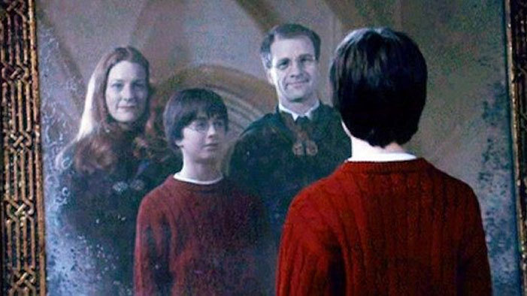
Online Meeting 9th July
Entertainment Quiz
Question 5
What are the names of Harry Potter’s parents?
Lily & James

Slide 10
Online Meeting 9th July
Entertainment Quiz
Question 5
What are the names of Harry Potter’s parents?
Lily & James

Slide 11
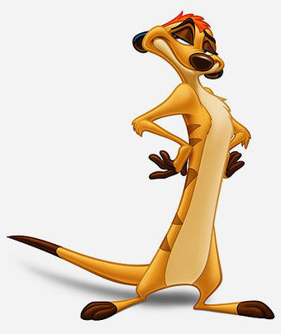
Online Meeting 9th July
Entertainment Quiz
Question 6
In ‘The Lion King’ what animal is Timon?
Meerkat

Slide 12
Online Meeting 9th July
Entertainment Quiz
Question 6
In ‘The Lion King’ what animal is Timon?
Meerkat

Slide 13
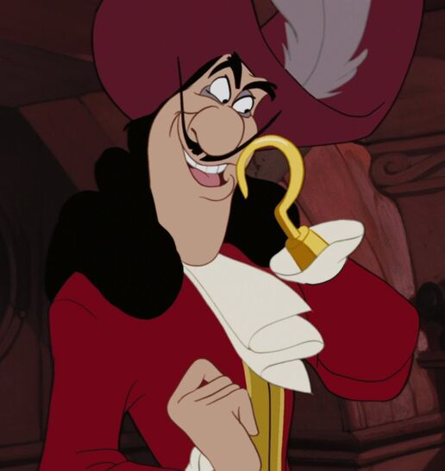
Online Meeting 9th July
Entertainment Quiz
Question 7
What is the name of Peter Pan’s pirate enemy?
Captain Hook

Slide 14
Online Meeting 9th July
Entertainment Quiz
Question 7
What is the name of Peter Pan’s pirate enemy?
Captain Hook

Slide 15
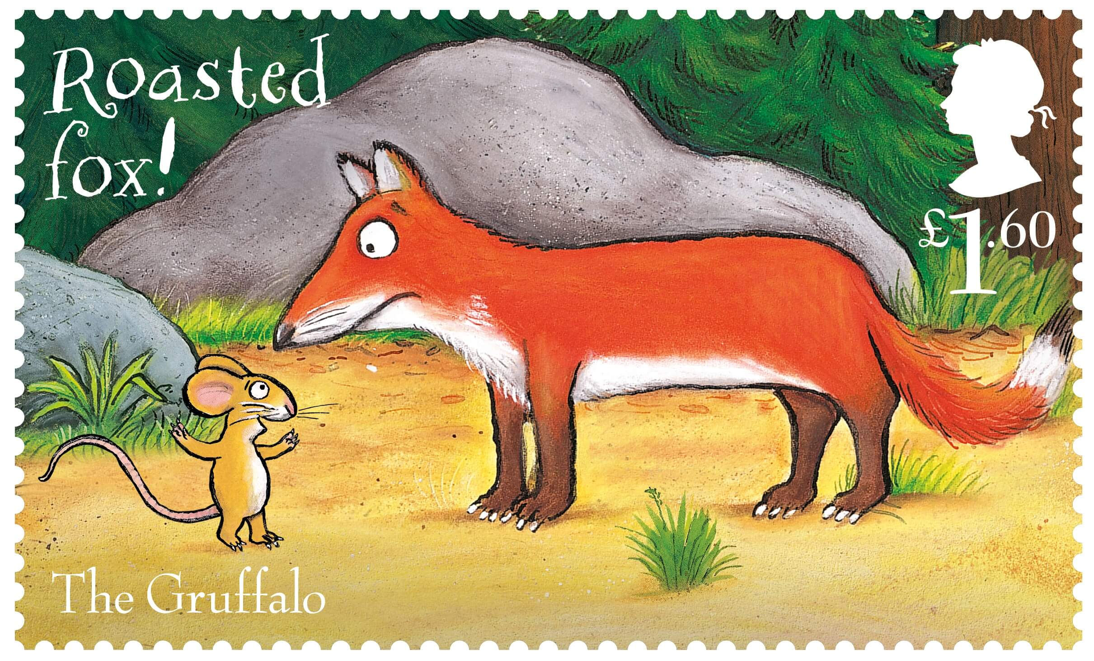
Online Meeting 9th July
Entertainment Quiz
Question 8
According to mouse, what is the Gruffalo’s favourite food?
Roasted Fox

Slide 16
Online Meeting 9th July
Entertainment Quiz
Question 8
According to mouse, what is the Gruffalo’s favourite food?
Roasted Fox

Slide 17
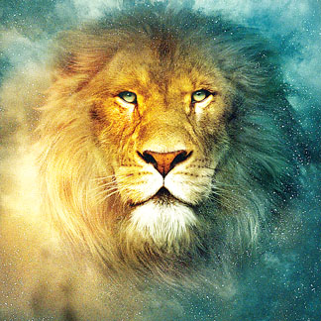
Online Meeting 9th July
Entertainment Quiz
Question 9
What is the name of the lion in ‘The Lion, The Witch & the Wardrobe’?
Aslan

Slide 18
Online Meeting 9th July
Entertainment Quiz
Question 9
What is the name of the lion in ‘The Lion, The Witch & the Wardrobe’?
Aslan

Slide 19
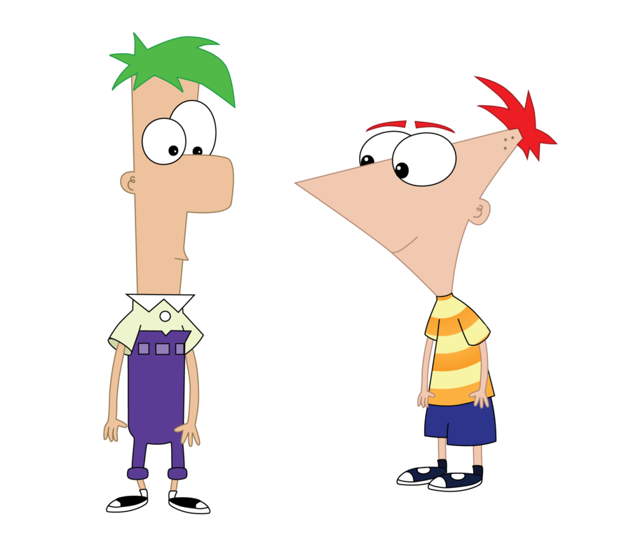

Online Meeting 9th July
Entertainment Quiz
Question 10
Which cartoon stepbrothers have “a 104 days of summer vacation”

Slide 20
Online Meeting 9th July
Entertainment Quiz
Question 10
Which cartoon stepbrothers have “a 104 days of summer vacation”

