Slide 1
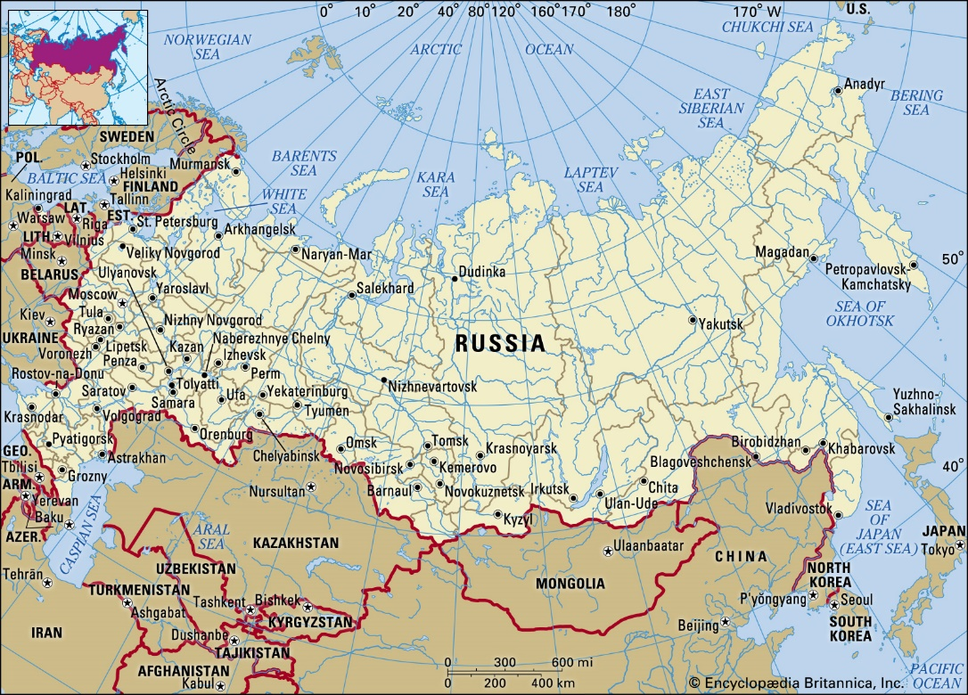
Online Meeting 25th June
  Geography Quiz
  Question 1
What is the largest country in the world?
Russia

Slide 2
Online Meeting 25th June
  Geography Quiz
  Question 1
What is the largest country in the world?
Russia

Slide 3
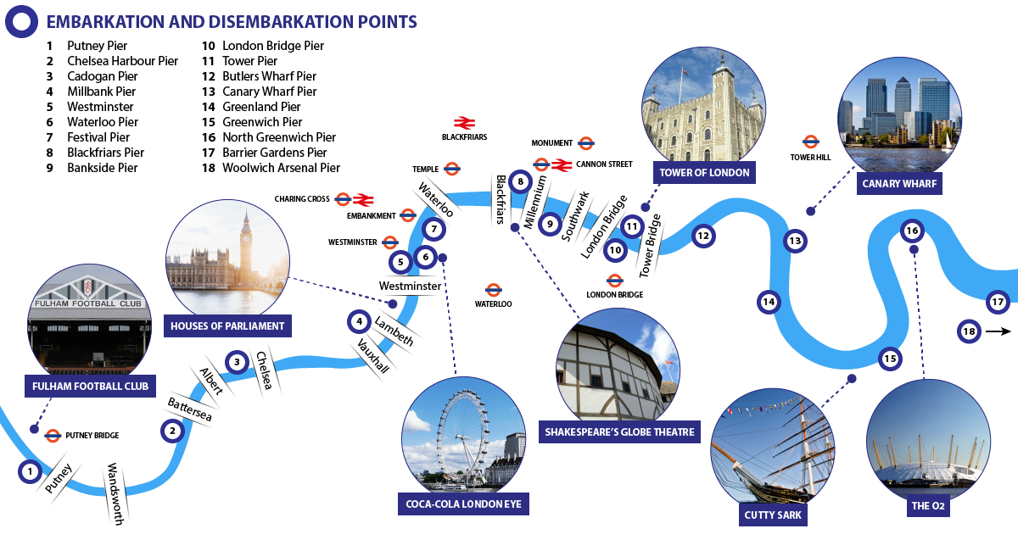
Online Meeting 25th June
  Geography Quiz
  Question 2
In which city would you find the River Thames?
London

Slide 4
Online Meeting 25th June
  Geography Quiz
  Question 2
In which city would you find the River Thames?
London

Slide 5
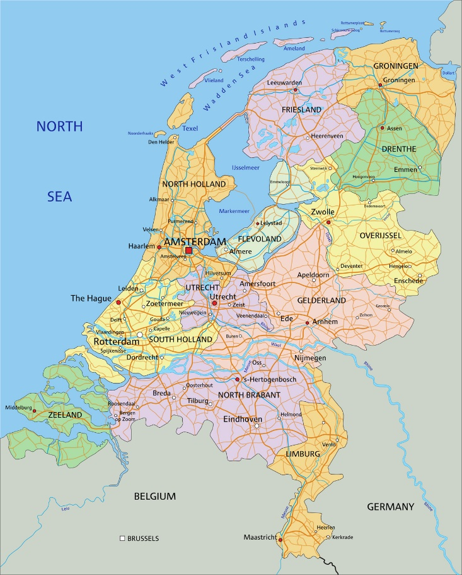
Online Meeting 25th June
  Geography Quiz
  Question 3
Which country is also known as the Netherlands?
Holland

Slide 6
Online Meeting 25th June
  Geography Quiz
  Question 3
Which country is also known as the Netherlands?
Holland

Slide 7
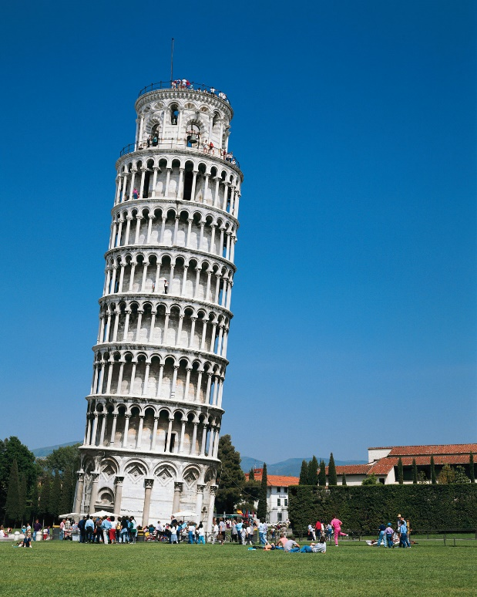
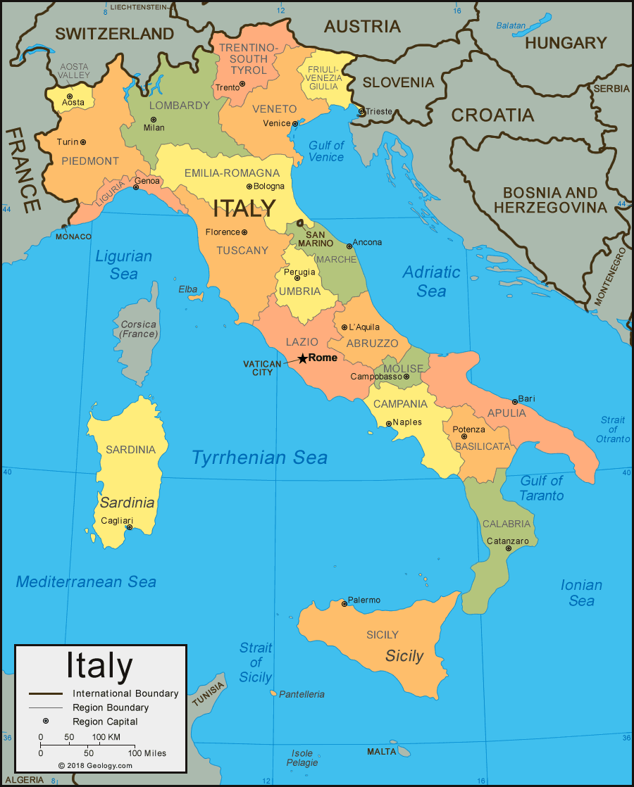
Online Meeting 25th June
  Geography Quiz
  Question 4
In which country would you find the
‘Leaning Tower of Pisa’?
Italy

Slide 8
Online Meeting 25th June
  Geography Quiz
  Question 4
In which country would you find the
‘Leaning Tower of Pisa’?
Italy

Slide 9
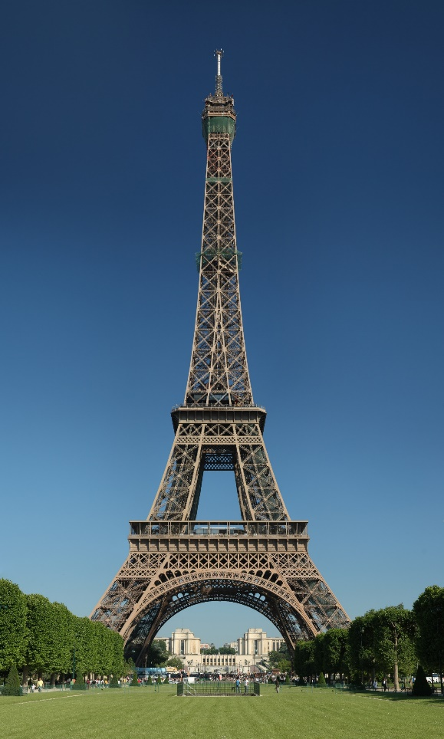
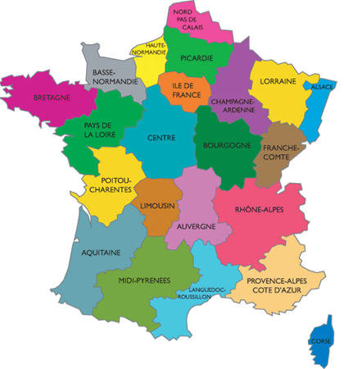
Online Meeting 25th June
  Geography Quiz
  Question 5
Where would you find the ‘Eiffel Tower’?
Paris (France)

Slide 10
Online Meeting 25th June
  Geography Quiz
  Question 5
Where would you find the ‘Eiffel Tower’?
Paris (France)

Slide 11
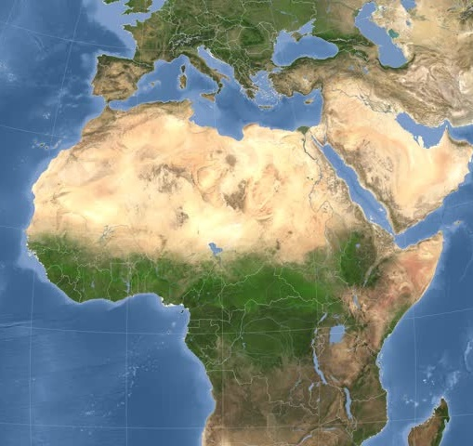
Online Meeting 25th June
  Geography Quiz
  Question 6
Which is the biggest desert in the world?
Sahara

Slide 12
Online Meeting 25th June
  Geography Quiz
  Question 6
Which is the biggest desert in the world?
Sahara

Slide 13
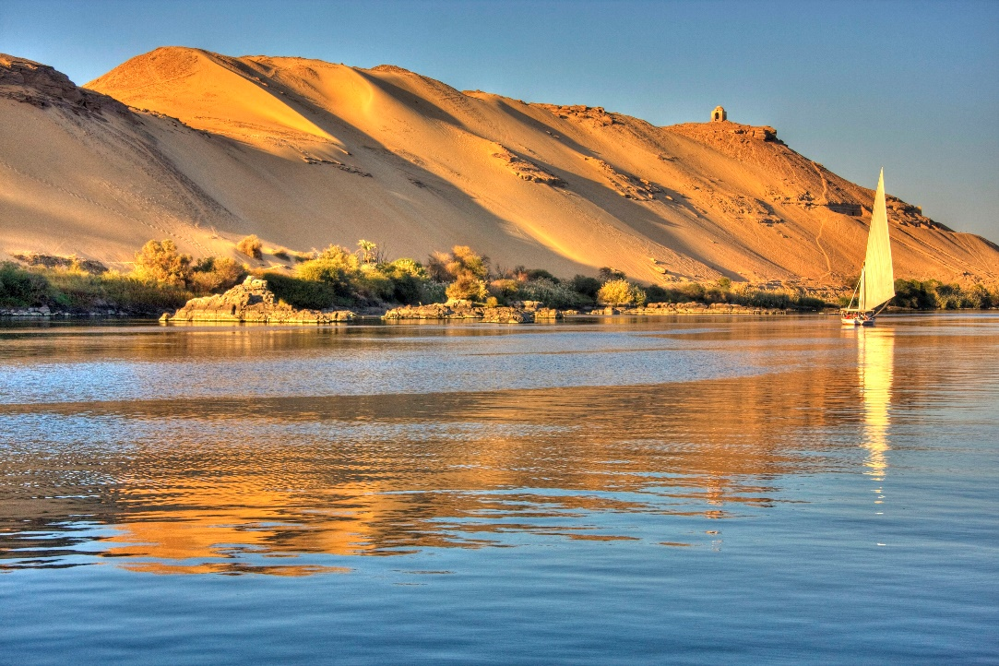
Online Meeting 25th June
  Geography Quiz
  Question 7
What is the longest river in the world?
6,650 kilometres
or 4,130 miles
The Nile

Slide 14
Online Meeting 25th June
  Geography Quiz
  Question 7
What is the longest river in the world?
The Nile
6,650 kilometres
or 4,130 miles

Slide 15
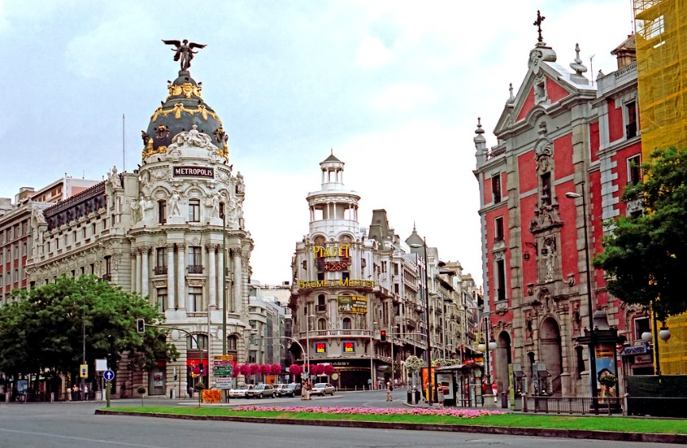
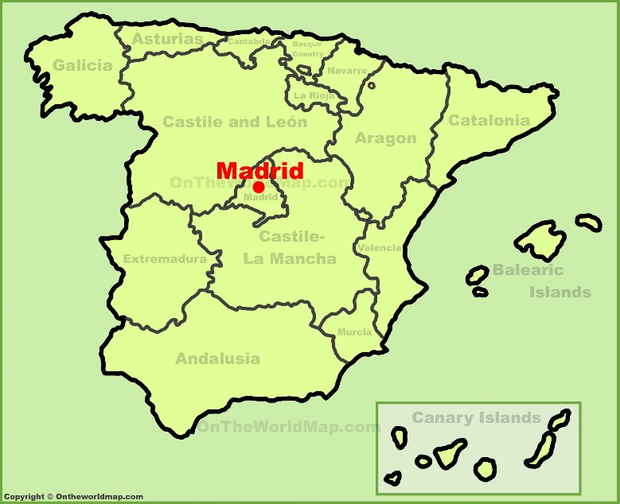
Online Meeting 25th June
  Geography Quiz
  Question 8
What is the capital city of Spain?
Madrid

Slide 16

Online Meeting 25th June
  Geography Quiz
  Question 8
What is the capital city of Spain?
Madrid

Slide 17
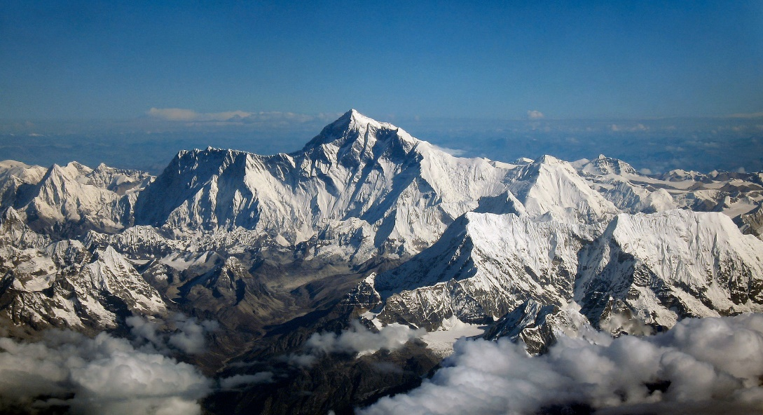
Online Meeting 25th June
  Geography Quiz
  Question 9
Mount Everest lies in which mountain range?
The Himalayas
8,848 meters high!

Slide 18
Online Meeting 25th June
  Geography Quiz
  Question 9
Mount Everest lies in which mountain range?
The Himalayas
8,848 meters high!

Slide 19
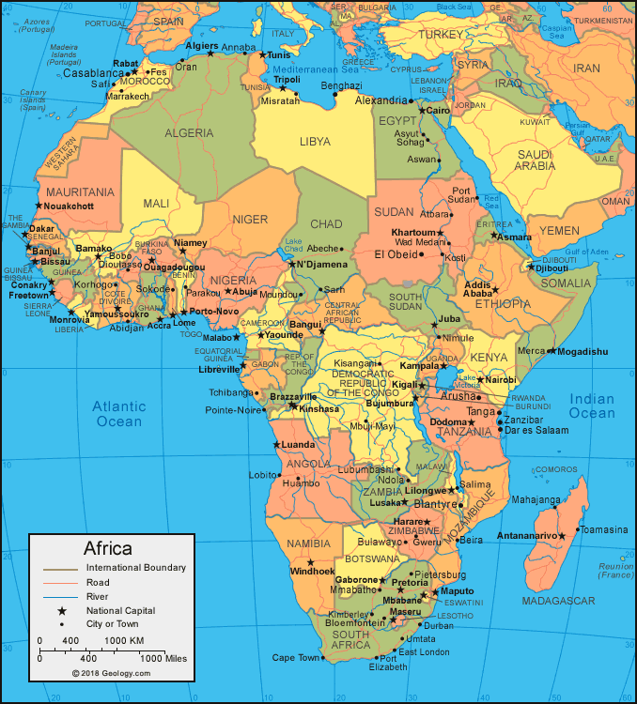
Online Meeting 25th June
  Geography Quiz
  Question 10
What is the hottest continent on earth?
Africa
Notes:
Average speed of 0.15mph

Slide 20
Online Meeting 25th June
  Geography Quiz
  Question 10
What is the hottest continent on earth?
Africa
Notes:
Average speed of 0.15mph

Slide 21
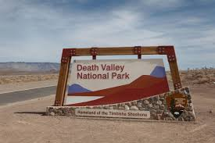
Online Meeting 25th June
  Geography Quiz
  Question 10 (Bonus)
What is the hottest place on earth?
134ºF
or 57ºC
Death Valley
(California)
Notes:
Average speed of 0.15mph

Slide 22
Online Meeting 25th June
  Geography Quiz
  Question 10 (Bonus)
What is the hottest place on earth?
Death Valley
(California)
134ºF
or 57ºC
Notes:
Average speed of 0.15mph

