Slide 1
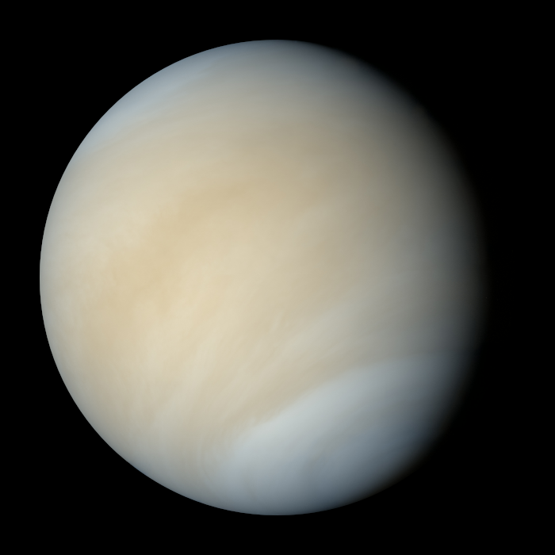
Online Meeting 18th June
  Science Quiz
  Question 1
What planet is nearest to Earth?
Venus

Slide 2
Online Meeting 18th June
  Science Quiz
  Question 1
What planet is nearest to Earth?
Venus

Slide 3
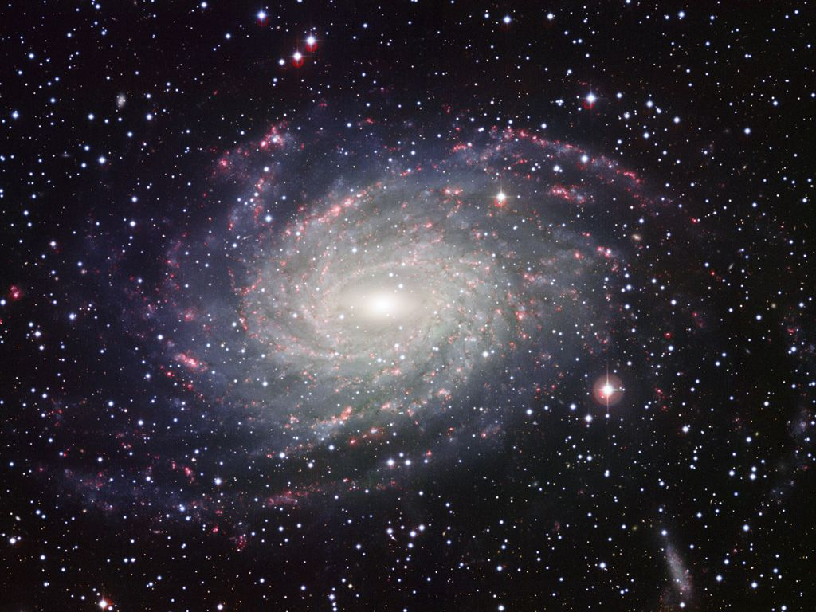
Online Meeting 18th June
  Science Quiz
  Question 2
The earth is located in which galaxy?
The Milky Way

Slide 4
Online Meeting 18th June
  Science Quiz
  Question 2
The earth is located in which galaxy?
The Milky Way

Slide 5
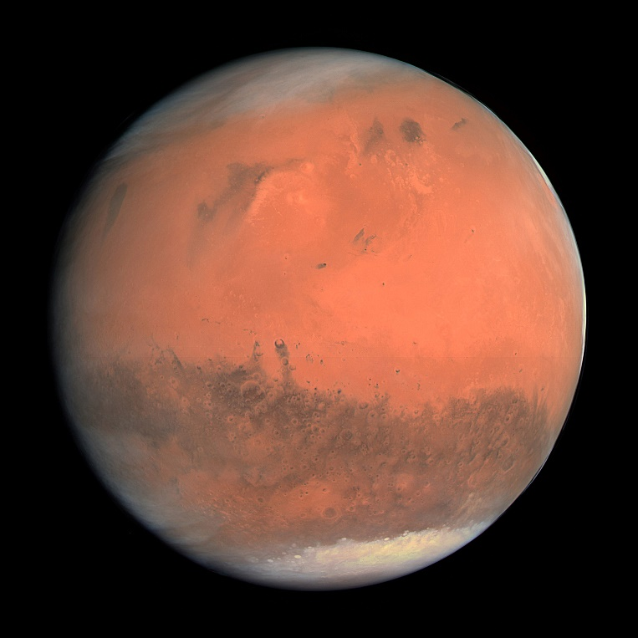
Online Meeting 18th June
  Science Quiz
  Question 3
What planet is known as ‘the red planet’?
Mars

Slide 6
Online Meeting 18th June
  Science Quiz
  Question 3
What planet is known as ‘the red planet’?
Mars

Slide 7

Online Meeting 18th June
  Science Quiz
  Question 4
Which travels faster, light or sound?
light

Slide 8
Online Meeting 18th June
  Science Quiz
  Question 4
Which travels faster, light or sound?
light

Slide 9
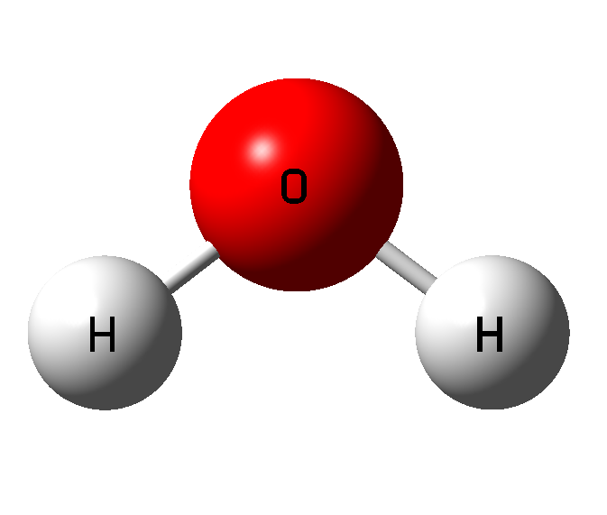
Online Meeting 18th June
  Science Quiz
  Question 5
What is the chemical formula for water?
H₂O

Slide 10
Online Meeting 18th June
  Science Quiz
  Question 5
What is the chemical formula for water?
H₂O

Slide 11
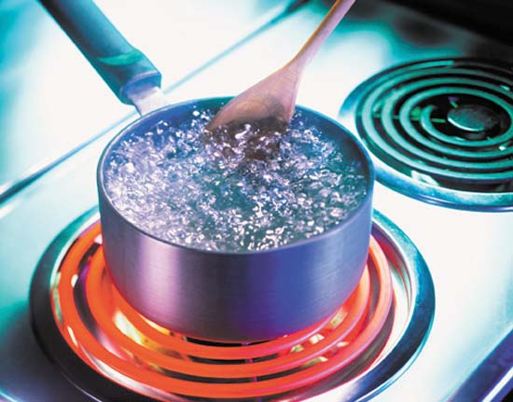
Online Meeting 18th June
  Science Quiz
  Question 6
What is the boiling point of water?
100ºC

Slide 12
Online Meeting 18th June
  Science Quiz
  Question 6
What is the boiling point of water?
100ºC

Slide 13
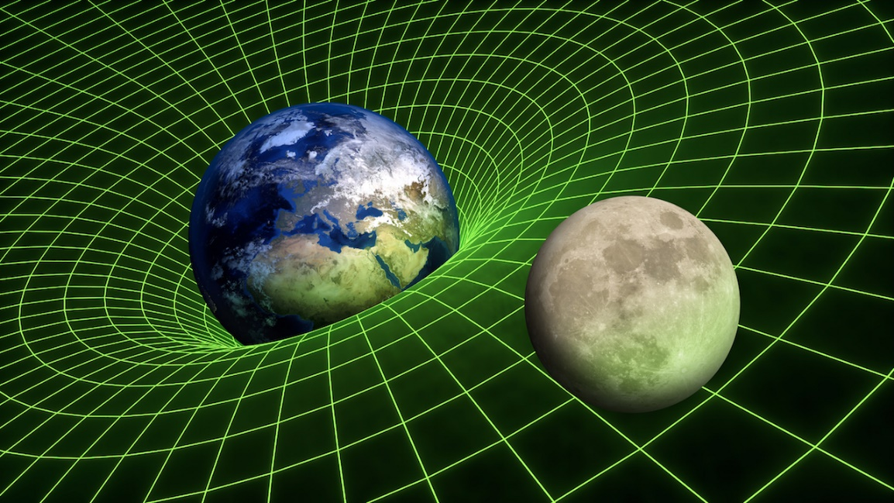
Online Meeting 18th June
  Science Quiz
  Question 7
What force pulls all objects towards the centre of the earth?
gravity

Slide 14
Online Meeting 18th June
  Science Quiz
  Question 7
What force pulls all objects towards the centre of the earth?
gravity

Slide 15

Online Meeting 18th June
  Science Quiz
  Question 8
What item attracts certain metals like iron?
A magnet

Slide 16
Online Meeting 18th June
  Science Quiz
  Question 8
What item attracts certain metals like iron?
A magnet

Slide 17
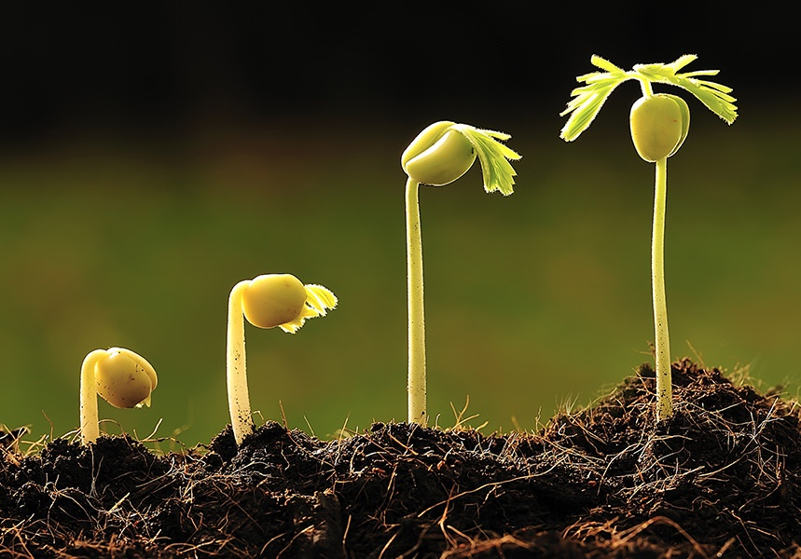
Online Meeting 18th June
  Science Quiz
  Question 9
Botany is the study of?
plants

Slide 18
Online Meeting 18th June
  Science Quiz
  Question 9
Botany is the study of?
plants

Slide 19
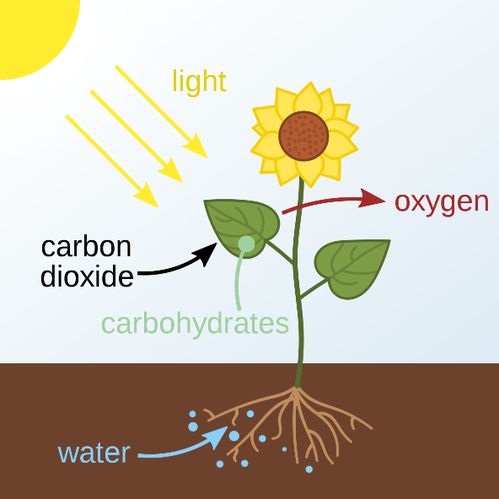
Online Meeting 18th June
  Science Quiz
  Question 10
What is the name of the process used by plants to convert sunlight into food?
photosynthesis
Notes:
Average speed of 0.15mph

Slide 20

Online Meeting 18th June
  Science Quiz
  Question 10
What is the name of the process used by plants to convert sunlight into food?
photosynthesis
Notes:
Average speed of 0.15mph

